Slide 1

State Policy Settings
- Local Contributions
Department of Planning, Housing and Infrastructure
Katrine O’Flaherty & Charlotte Dare
infrastructure.contributions@planning.nsw.gov.au
June 2025

Slide 2
State Policy Framework for Local Contributions
Part 7
EP&A Act 1979
Part 9
EP&A Reg 2021
Ministerial Directions
Planning Secretary Practice Notes

Slide 3

2025 Practice Notes: Rules, tools and templates
https://www.planningportal.nsw.gov.au/local-infrastructure-contributions/practice-notes-home
PIA Infrastructure Funding & Delivery
Notes:
Practice notes are guidance for council practitioners to help them understand and use the local infrastructure contributions system.
Councils have told us they want
simpler, modernised guidance
more examples, templates, information and data
opportunities to collaborate and ask questions on specific issues
Transform how we deliver the practice notes – moving away from static PDF document to digital first
Existing practice notes were introduced between 2005-2021
Inconsistent and out of date
difficult to find and use
hard to update
New practice notes:
Written in plain language and with consistent format
Updated to clarifying policy intent
New best practice guidance and new worked examples

Slide 4





Local
Infrastructure contributions system
Administering contributions
New practice notes covering the whole system
Section 7.11 contributions
Section 7.12 levies
Planning agreements
New practice notes for each mechanism
PIA Infrastructure Funding & Delivery

Slide 5
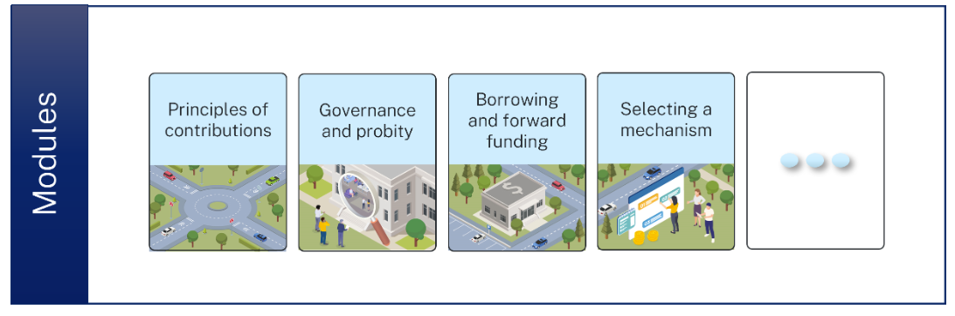
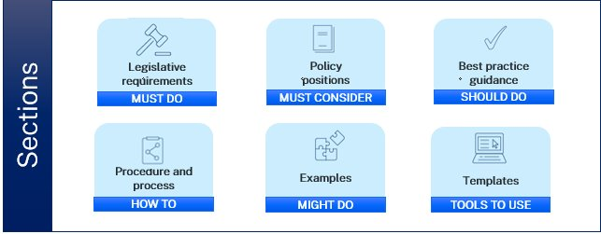
2025 Practice Notes: Structure

Slide 6
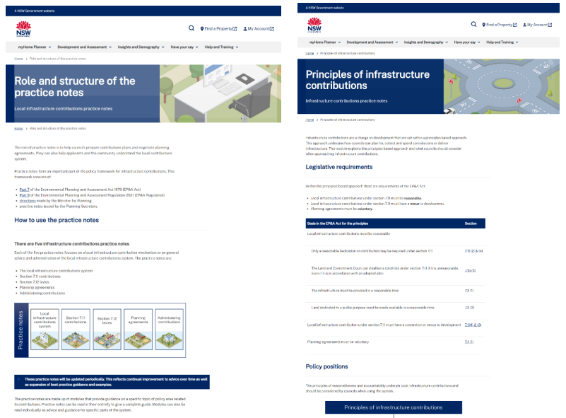
Digital delivery via the NSW Planning Portal
Transforms the way you access information.
Provides a platform for information sharing and collaboration.
Facilitates ongoing improvement over time.
Notes:
Moving away from static PDFs to a dynamic and digital first delivery
The digital format will make the practice notes easier to navigate.
Centralised guidance with interlinked webpages inbuilt search functions
more user friendly and informative
interlinking between policy topics
embedded popup definitions
Examples and templates
Creating culture of collaboration and continual improvement
Practice notes and digital hub are by nature more interactive than PDF docs
We are building in easy ways to receive feedback and communication
Councils are both audience seeking advice and expert practitioners
We want to hear from councils and other stakeholders and will use their input to build this resource

Slide 7
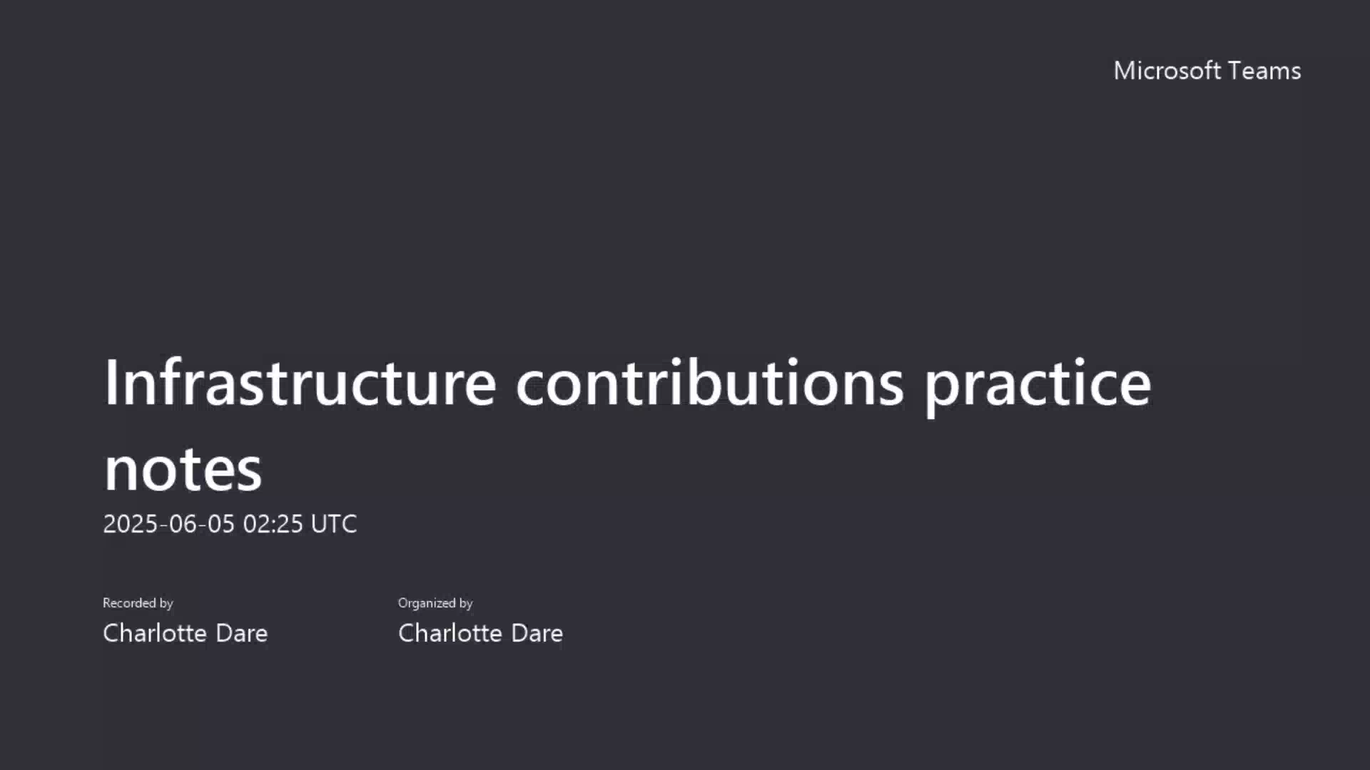
Walk through

Slide 8
2025 Secretary Practice Notes
PIA Infrastructure Funding & Delivery

Slide 9
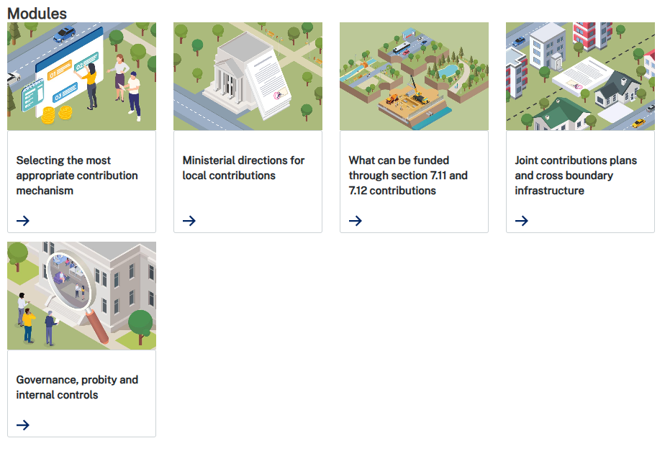
System practice note

Slide 10
System practice note – What we heard
Practical considerations when selecting a mechanism, establishing governance or thinking about cross boundary plans
Feedback on the content and clarity of Ministerial directions
Questions about what can be funded and how things are defined
Requests for more information on affordable housing and contributions for state led planning pathways
A need to know how changes will be communicated

Slide 11
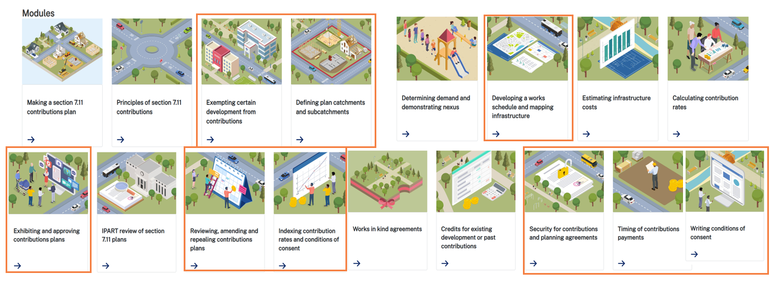
Section 7.11 practice note

Slide 12
Section 7.11 practice note – What we heard
Interest in more templates, tools and worked examples
Requests for advice on deferred payments, discounts and credits
Questions about reviewing and repealing plans
Requests for guidance on costs including benchmarks and contingencies
The complexity of land acquisition and process for works in kind
Feedback on the IPART review process

Slide 13
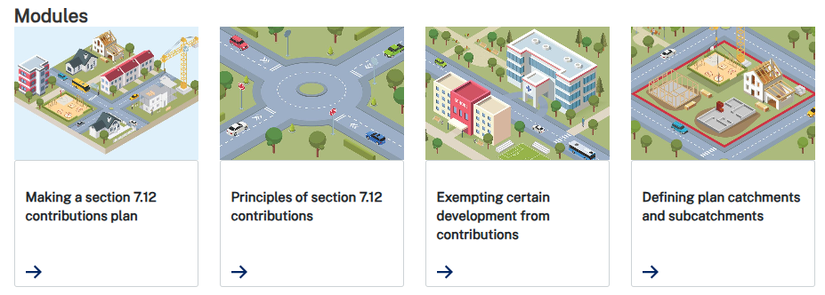
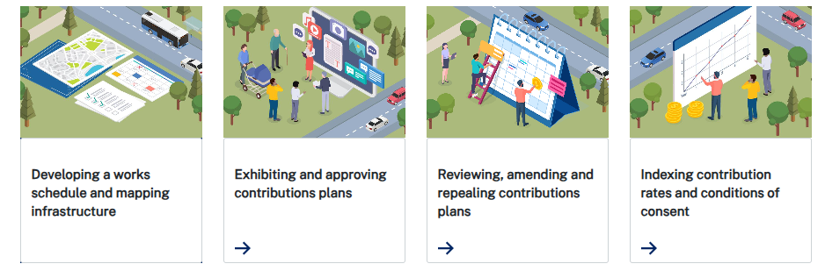
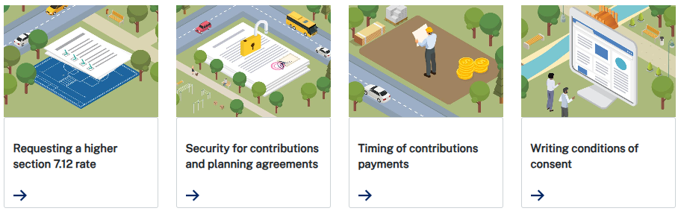
Section 7.12 practice note

Slide 14
Section 7.12 practice note – What we heard
Perceived changes to nexus and apportionment
Requests for guidance on calculating the cost of development
A need for clarification regarding mandatory exemptions and the role of works in kind
Confusion about the role of IPART
Questions about the process for seeking a higher rate

Slide 15
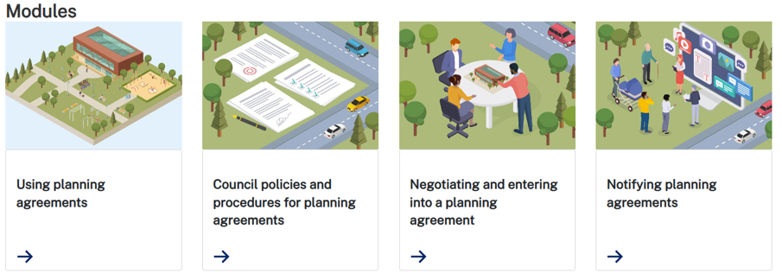
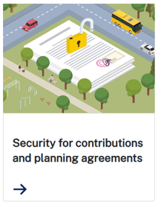
Planning agreements practice note

Slide 16
Planning agreements practice note – What we heard
Requests for templates and training
Requests for clearer guidance on planning agreement policies and negotiation support
Clarification on the acceptability test
Perceived changes to value capture policy

Slide 17
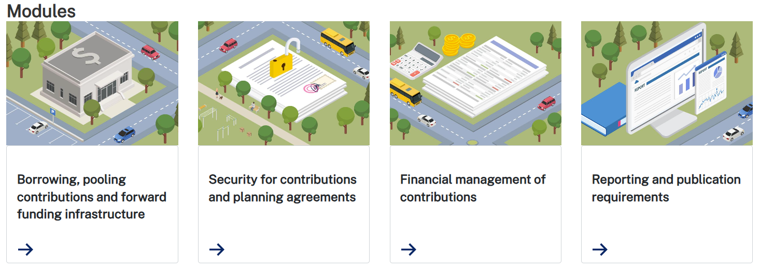
Administration practice note

Slide 18
Administration practice note – What we heard
Request for more assistance on cashflow, borrowing and pooling
Need for policy advice for repealing plans
Suggestions on different approaches to security
Positive and negative feedback on reporting
Complex local government accounting questions
Support needed on the challenges of infrastructure delivery

Slide 19
What's Next?
State Policy Framework for Local Contributions

Slide 20

What’s Next?
Planning Agreements
Recommendation 6
Consider amendment of the EP&A Regs to require demonstration of certain matters being considered before entering into a planning agreement.
Recommendation 7
Guidelines and training to assist councillors in their decision-making role in respect of planning agreements
Recommendation 8
Guidance on the essential information that must be submitted with a letter of offer.
Recommendation 9
Risk-based audits of planning agreements negotiated by councils

Slide 21

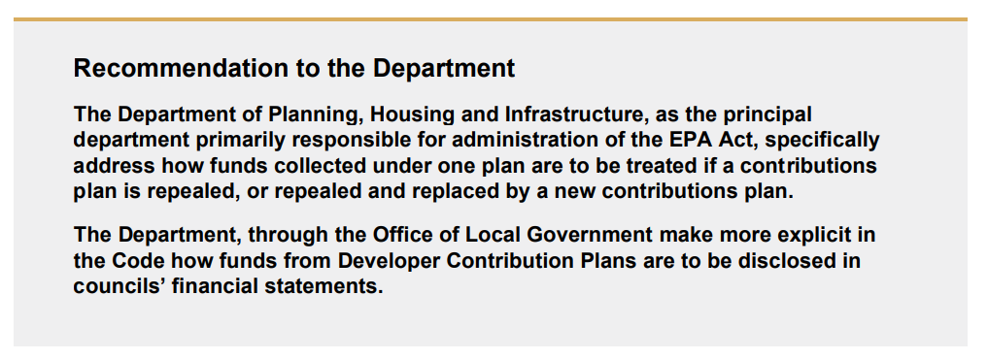
What’s Next?
Repealed Funds

Slide 22
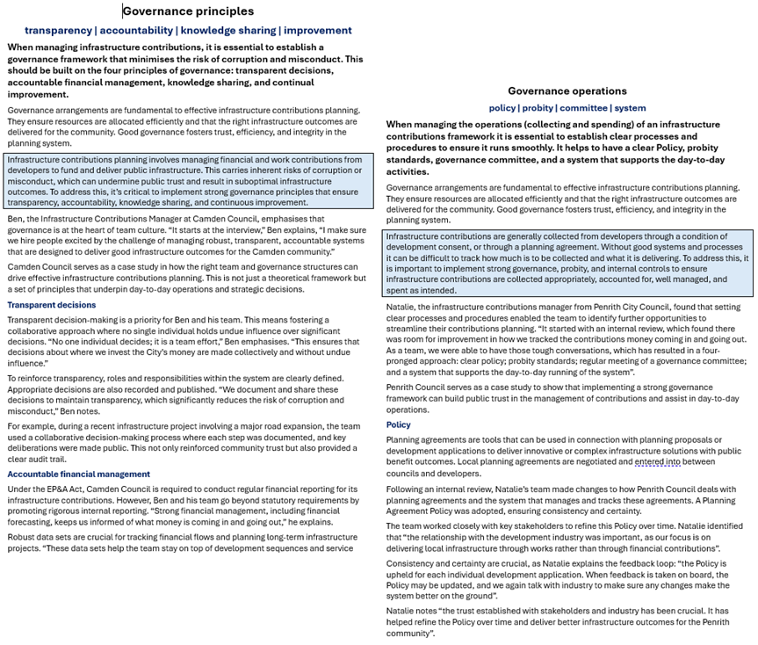
What’s Next?
Continue to improve the Practice Notes by sharing practitioner stories, tools and templates
Share your story

Slide 23
Thank you
infrastructure.contributions@planning.nsw.gov.au
PIA Infrastructure Funding & Delivery

