Slide 1
Holistic local infrastructure funding
PIA Planner’s Summit, Day 1, 10 June
Jonathon Carle, Associate Director – Infrastructure

Slide 2
Overview
Common approach
Holistic approach
Tendency to focus on local contributions
Limited consideration of other (non-contributions) funding mechanisms
Limits on contributions means they rarely fully fund infrastructure
Difficult for councils to fund the ‘gap’ using budget funding
Less infrastructure
Loss erosion of public trust
Consider the full range of funding mechanisms available
More and better infrastructure
Financial sustainability
Pulblic trust

Slide 3
What we’ll cover
Limits of s7.11 and s7.12 contributions
Council funding constraints
Holistic infrastructure funding mechanisms
Case studies
Tools
Wrap up

Slide 4
Limits to s7.11 & s7.12
s7.11
s7.12
$20k/dwelling cap (2011)
IPART essential works list (EWL)
Apportionment
1% of development cost
Can go higher if approved by Minister and meets s7.12 Practice Note criteria, but rates above 3-4% ($20k
Limited to precincts

Slide 5
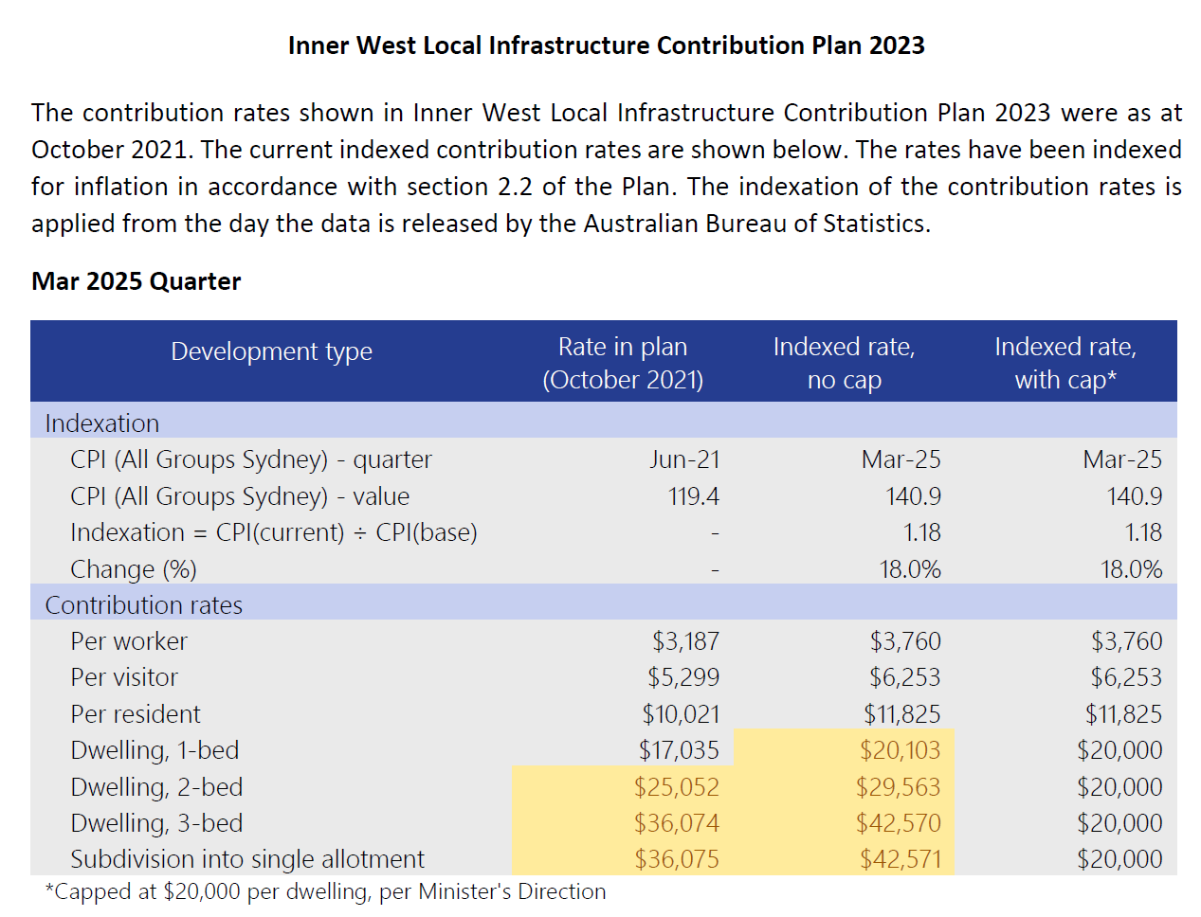

Slide 6
Inner West capital works expenditure 21/22 by funding source
Contributions funded 25% of capital expenditure

Slide 7
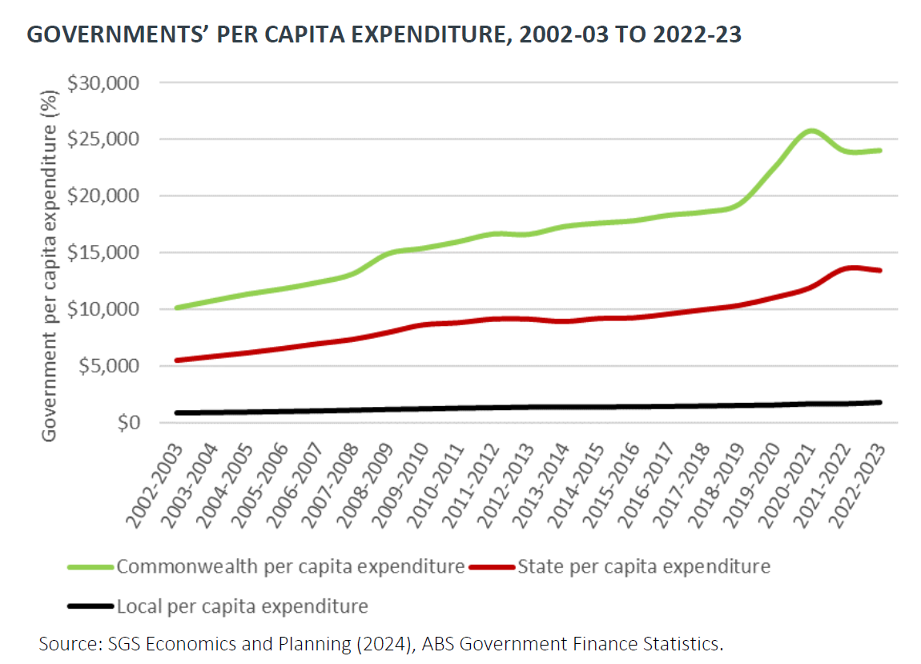
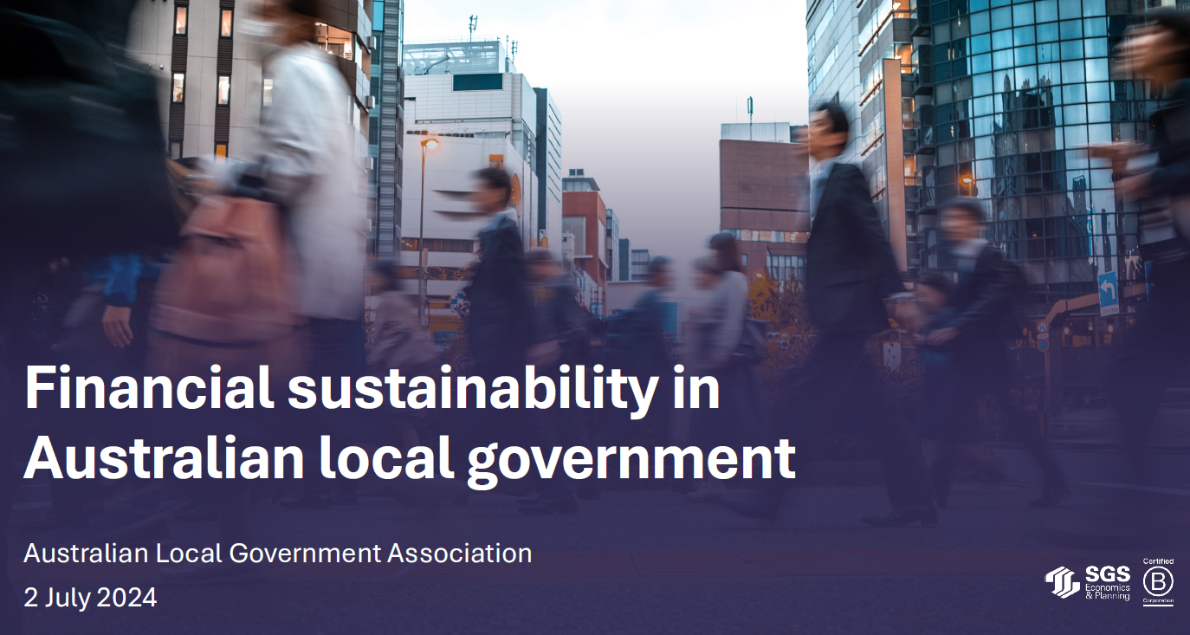

Council funding constraints

Slide 8
Holistic funding mechanisms
Planning system
Other
Local contributions (s7.11, s7.12)
Planning agreements
Developer works conditions
‘Key sites’ incentive clause
Affordable housing contributions
Water and sewer headworks changes
Grants
General revenue (rates etc)
Special rate variation (SRV)
Asset recycling
Borrowing

Slide 9
Developer works condition
s4.17 of the EP&A Act
Examples
When granting consent to a development, consent authorities can impose a condition requiring works
To mitigate the impact of the development
Can be on off (e.g. next to) the development
Enabling works e.g. local roads within a subdivision development development
Upgrade (signalisation) of an intersection adjoining a proposed Bunnings or McDonalds
Streetscape footpath upgrades adjoining a development site e.g. paving

Slide 10
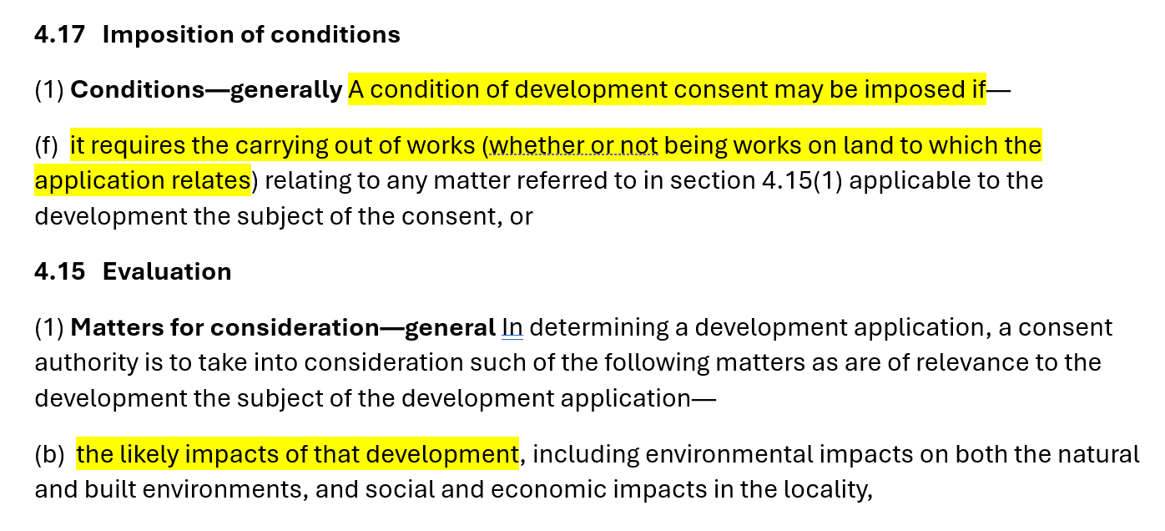

Slide 11
‘Key sites’ incentive clause
When a site is rezoned e.g. for residential use with increased FSR and height, the land value may increase
Where this occurs, the development feasibility may change so there will an ‘increased capacity to pay’ i.e. provide infrastructure on the site, in addition to local infrastructure contributions
A site-specific clause is inserted into the planning instrument enabling the developer to access increased FSR, height etc at the development application (DA) stage in return for providing defined community infrastructure on the site
Can be an effective way to overcome limitations of s7.11 and s7.12 local infrastructure contributions
A companion clause will be included in the DCP identifying the Community infrastructure commonly identified in a DCP e.g. open space, community facilities
Works best on large ‘key sites’ with significant land value uplift
Feasibility testing is critical to ensure development remains feasible
Examples: DPHI (Macquarie Park), City of Sydney (Green Square), Canada Bay (Parramatta Rd Corridor), Ryde (Macquarie Park), Lane Cove (St Leonards South)

Slide 12
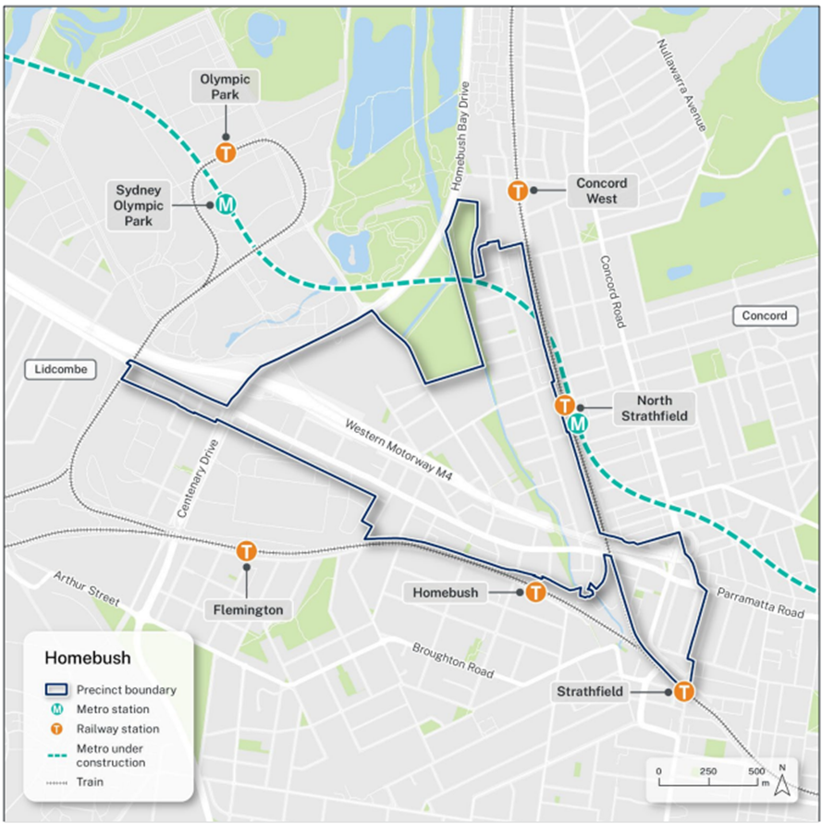
Example: Homebush TOD ‘key sites’ clause
NSW Transit Oriented Development (TOD) program – State-led rezoning
Homebush TOD straddled 2 LGAs: Strathfield and Canada Bay
Council LEPs rezoned in November 2024
Key sites clause on certain sites – developers can access increased height and floorspace if they provide defined community infrastructure on their site
Details provided in a ‘Precinct Design Guide’ (similar to DCP)

Slide 13
Figure 12: Key sites map

Slide 14
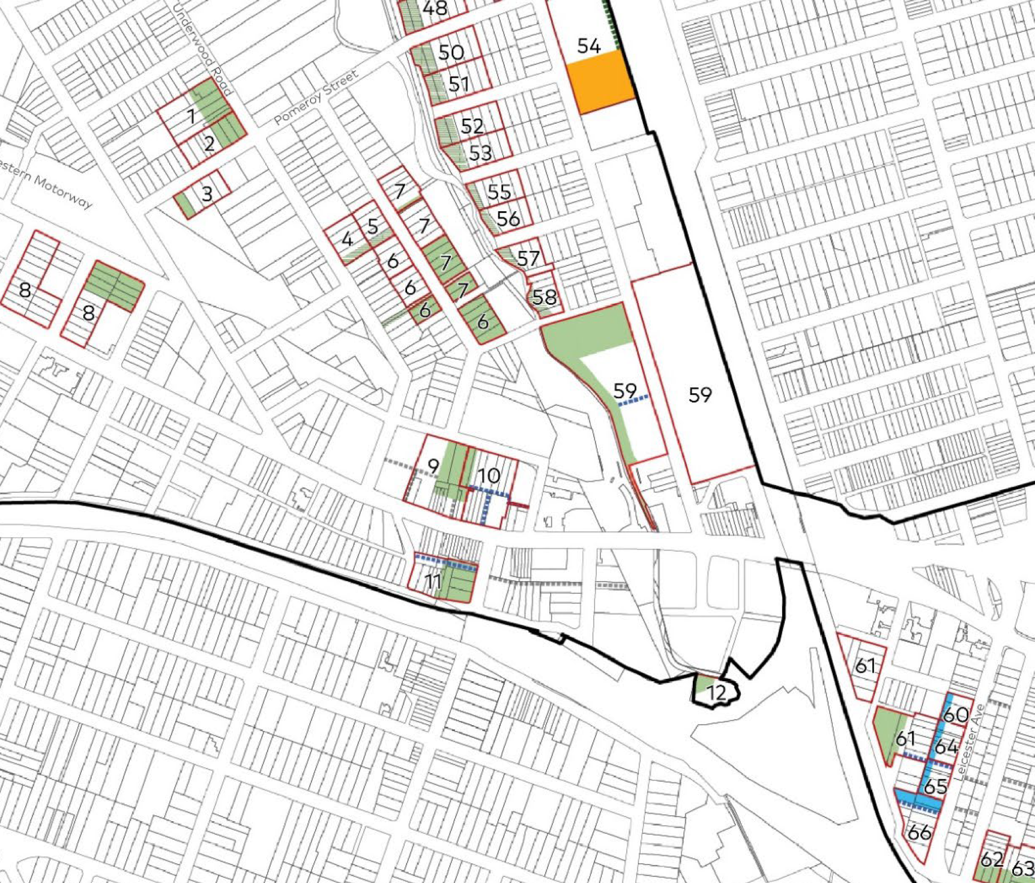
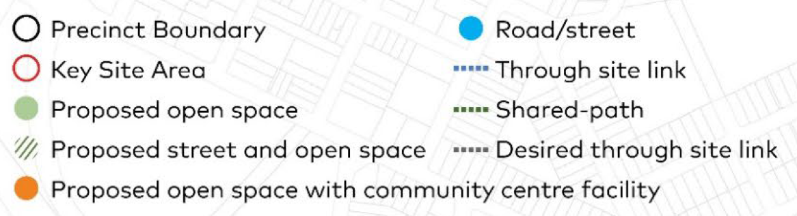
Figure 12:
Key sites map

Slide 15
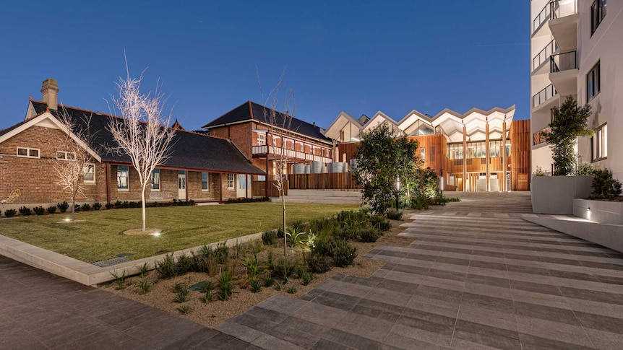
Asset recycling
Marrickville Library

Slide 16
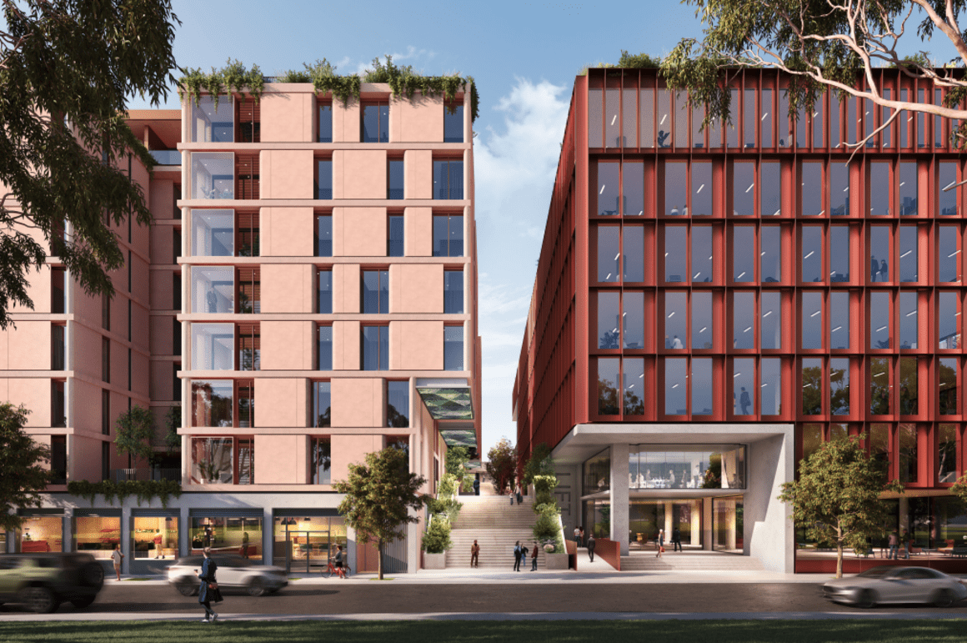
Asset recycling
Former City of Sydney depot site
Former City of Sydney-owned depot site opposite Wentworth Park in Pyrmont
Council offered the site to the market for residential redevelopment (230 apartments) subject to delivering a childcare facility & Council-owned indoor recreation centre

Slide 17
Borrowing
Option to fund key infrastructure through external borrowings
Borrowings can include:
  loans from commercial providers
  T-Corp low-cost loans from NSW Treasury
Borrowings come with challenges:
  Debt servicing – general fund, rates revenue, special rate variations?
  Competing infrastructure priorities - which project gets a guernsey?
  Council debt to service ratio and “Fit for the Future” criteria which limits the extent of borrowings
  Interest costs incurred

Slide 18
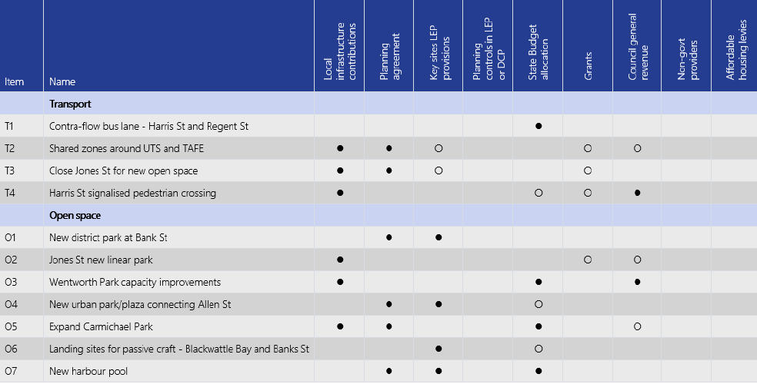
Tools: Infrastructure delivery plans

Slide 19
Tools: Gap funding plan
Costs ($125m)
Funding ($125m)
Notes:
Might also mention cash flow and staging

Slide 20
Idea: Local Infrastructure Strategy (LIS)
There is currently a ‘missing middle’ between:
  Local Strategic Planning Statement (LSPS)
  Local Infrastructure Contribution Plan (LICP)
LSPS includes minimal info on infrastructure needs, costs, funding and delivery
LICP includes extensive detail but difficult to follow for most stakeholders and only covers contributions works
LIS would consider existing and future needs, all types of infrastructure, all types of infrastructure funding and delivery mechanisms, and outline Council’s strategy
Could also act as an advocacy vehicle for State infrastructure

Slide 21
Wrap up
Invert the pyramid!
Other funding
Contributions
Conditions of consent
Incentive clause
Contributions
General revenue etc

Slide 22
Questions?
Holistic infrastructure funding
10.35 – 10.40 am

