Slide 1
Contributions plans for developments generating heavy vehicle movements =
Heavy Haulage CPs

Slide 2
Heavy haulage contributions plans
What are they?
    Heavy haulage plans are unique s7.11 plans
    Why? Only s7.11 plans that allow councils to levy for maintenance works.
      The maintenance is specific - road maintenance only due to road surface deterioration and can include drainage works
    The contributions are levied continually (usually retrospectively) over the life of the project that creates the haulage movements.

Slide 3
Heavy haulage contributions plans
How did this happen?
      Donges. C.C. and Associates v Baulkham Hills Shire Council (1989)
      Case was about the additional wear on council roads caused by extractive industry (sand) and therefore the extra burden placed on council to maintain those roads.
      Roads maintained by both Baulkham Hills and Hornsby Councils.
      Court agreed the developer should provide council with a monetary contribution for the additional maintenance required on the road under former s94 of EP&A Act.
      Contribution rate = $ value per tonne of material (extracted and hauled)

Slide 4
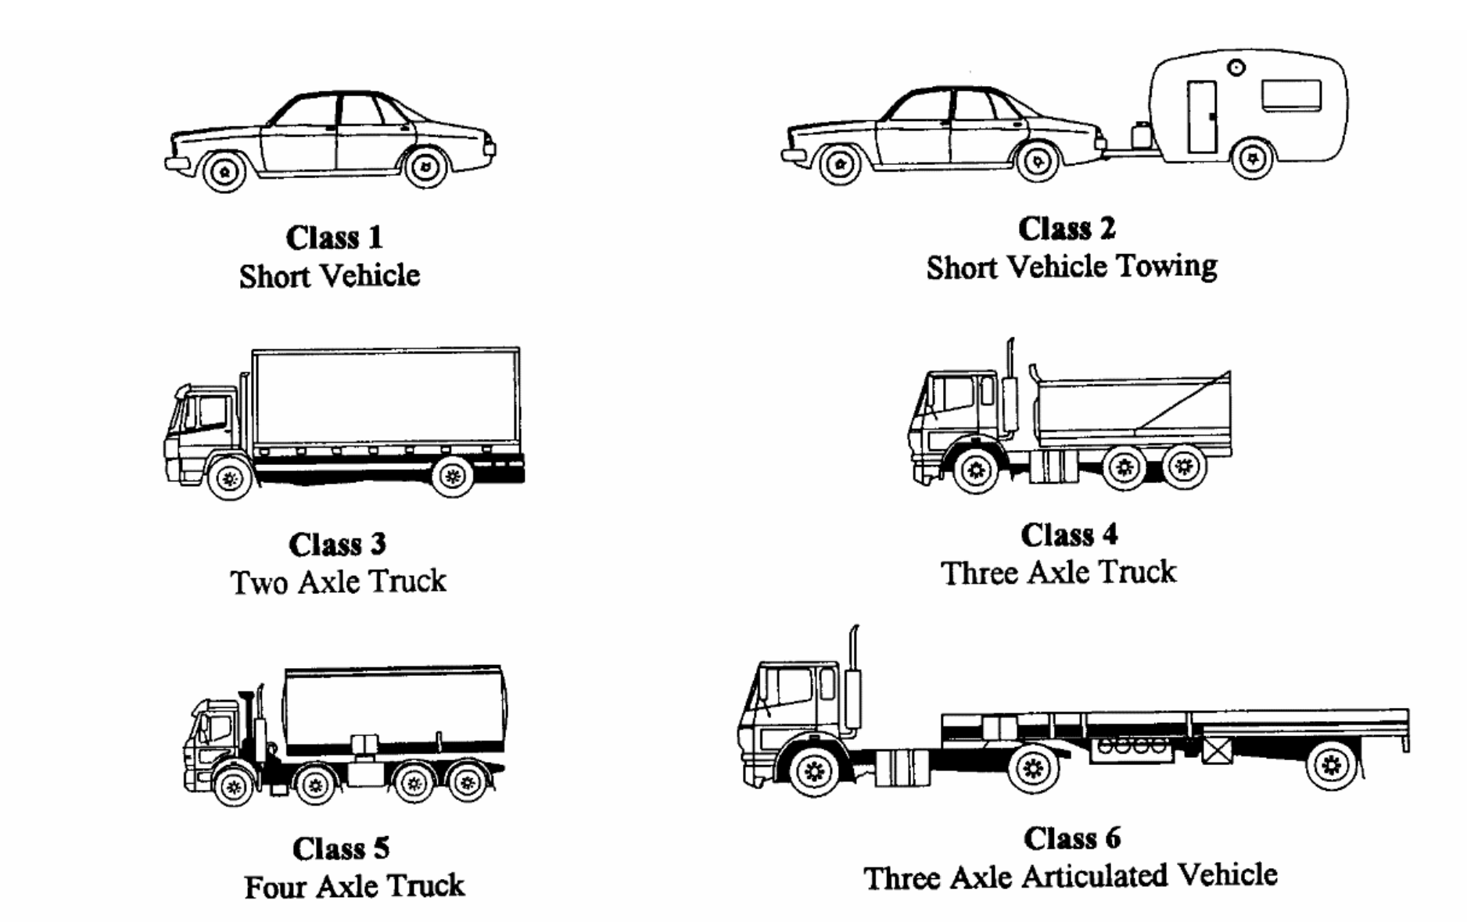
Road design basics
Road design
    Road design and pavement(s) have a limited ‘design’ life
    The life of the road is expressed in Equivalent Standard Axles (ESA)
    All road vehicles are divided into Classes that are based on the number of ESAs of the vehicle (12+ classes)
    Image source: Austroads.gov.au – vehicle classification system

Slide 5
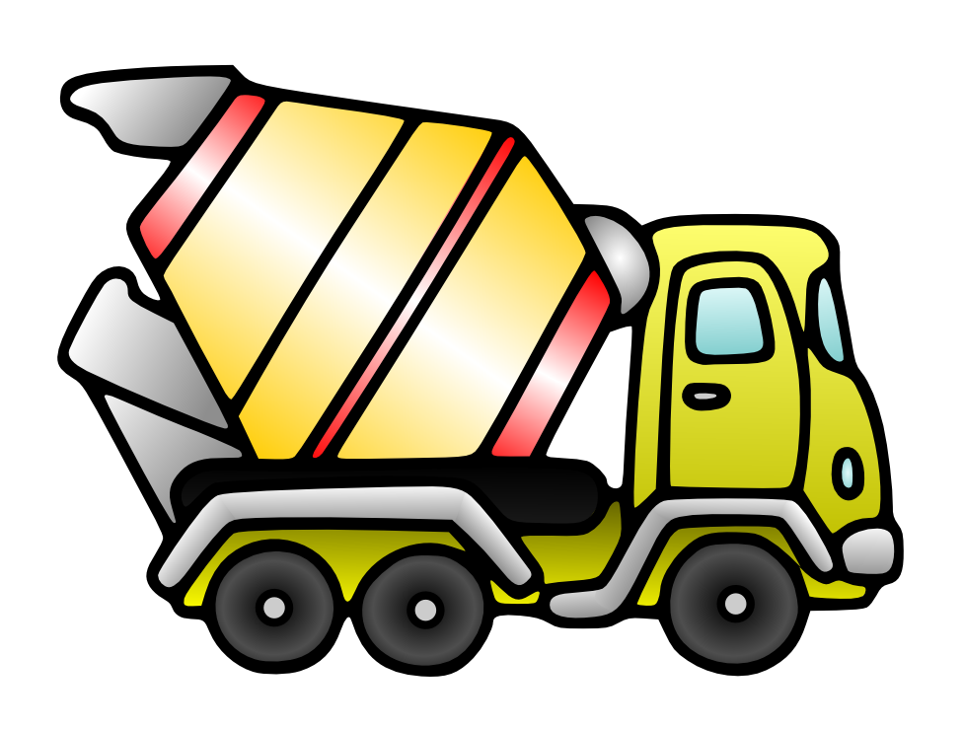
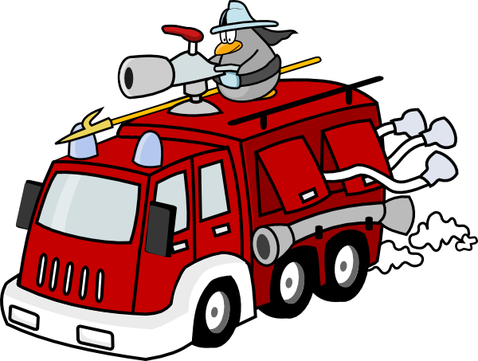
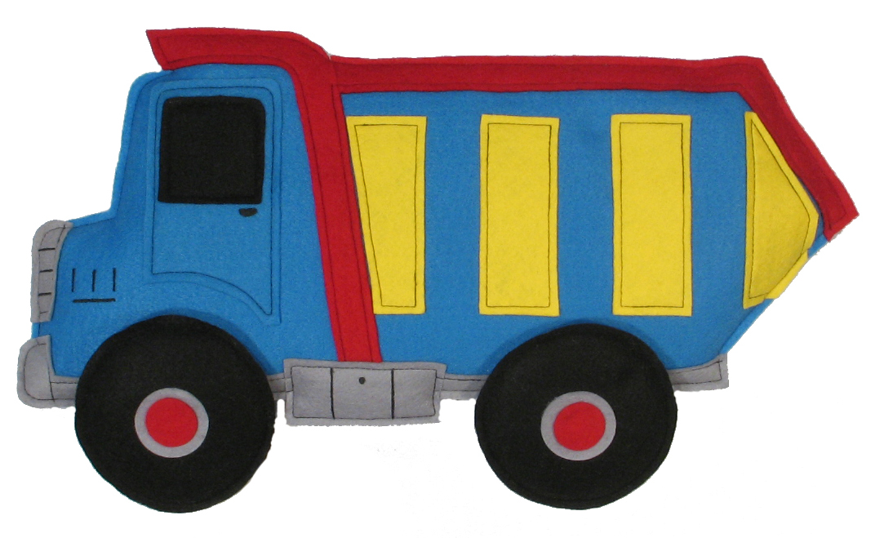
Road design - continued
    Road pavement deterioration occurs due to the multiple passes over the surface by the heavy vehicle classes. That is, cars and small vans don’t damage the roads because they don’t exert enough downward pressure.
    The contributions formula is based on the damage caused by a ‘typical’ haul vehicle on a ‘typical’ pavement type
    Images: clipart-library.com

Slide 6
How is the contribution rate calculated ?
  The ESAs of the road design type and the ‘standard axle’ configuration of a typical haul truck to determine the amount of damage caused to the road when the truck uses it.
  For example:
  A typical council local road has a life of 1,000,000 ESA
  A typical haul vehicle may have a configuration of 3.2 ESA
  So, the vehicle is reducing the life of the road by 3.2 ESA with every pass
  We use the logic to derive a contributions formula that works out the ‘cost’ of the damage the truck does when it uses the road, and levy that cost as the contribution amount.
  To do that, we ask the council to provide us with the lifetime cost of the road if the road was not used by heavy vehicles. This is because the road will eventually need reconstruction due to the accelerated deterioration. Instead of 30 years, the road may last 15 years.

Slide 7
Approach 1: to calculate the contribution rate
  Most plans levy a contribution that is:
  $ per tonne of material hauled (per km of haul road)*
  The developer is required to:
  provide evidence of the amount of material that has been extracted and hauled over the period (usually quarterly) to the council, and
  pay the contribution amount invoiced by the council.
  * Typically only the loaded truck is levied, not the empty return trip

Slide 8
Approach 2: to calculate the contribution rate
  For former Harden Council (now Hilltops) we developed a different approach (requested by them) because they believed that due to the lack of weigh stations in the LGA, the developers were not being completely honest about the amount of haulage being done.
  Our solution – lets count the trucks!
  Set up a traffic classifier at the entry/egress gate and provide the data to council. The classifer provides the number of movements and also the break-up of ESAs according to vehicle class.
  The rate is $ per ESA (per km of haul road).
  developer provides the traffic classifier data to the council (usually quarterly)
  the council then invoices the contribution amount based on data.

Slide 9
Typical Contributions calculations
The contribution calculation:
  Contribution $ = $Rate (per tonne) x No. of tonnes hauled x the length of road(s)
  OR
  Contribution $ = $Rate (per ESA) x No. of ESAs x the length of road(s)

Slide 10
Voluntary planning agreements
Instead of specific contributions plans
Sensible option for councils with few developments that generate heavy haulage

Slide 11

Questions
Image from - https://www.freepik.com/free-photos-vectors/happy-truck

