Slide 1
Contributions on renewable energy development
PIA Planner’s Summit, Infrastructure, Funding and Delivery 12 June 2025
Patricia Sim, Senior Infrastructure Planner
Notes:
This topic might be more focused on regional councils with this type of development but I think the mindset and the thinking around this topic is valuable for everyone in the contributions and infrastructure funding space.
We’ve been working with clients to get around what this means for local contributions
I’ve got a short timeslot today so I’m happy to take questions after and do a longer chat with anyone after the preso but for today I’ll breeze through a general overview of the development we can expect from now till 2050, a lot of movement in this space, Council’s opportunities, risks and response to emerging issues

Slide 2
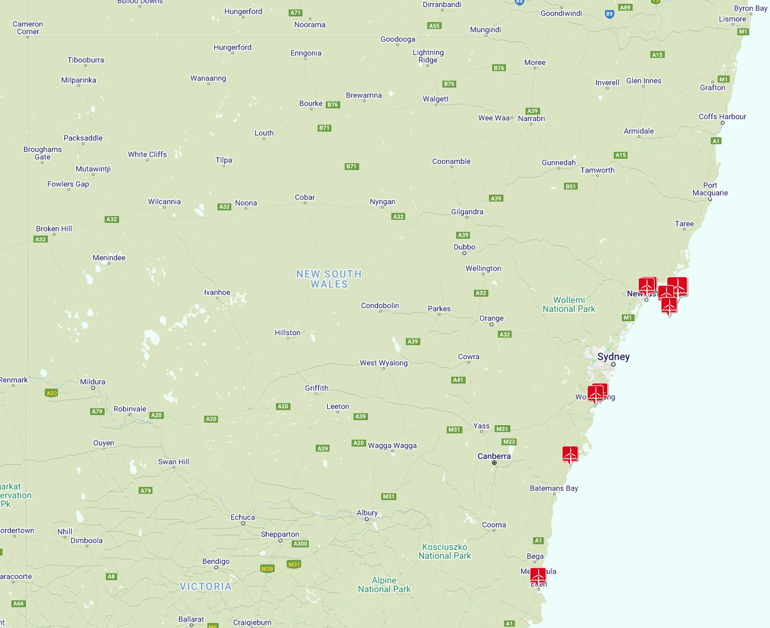
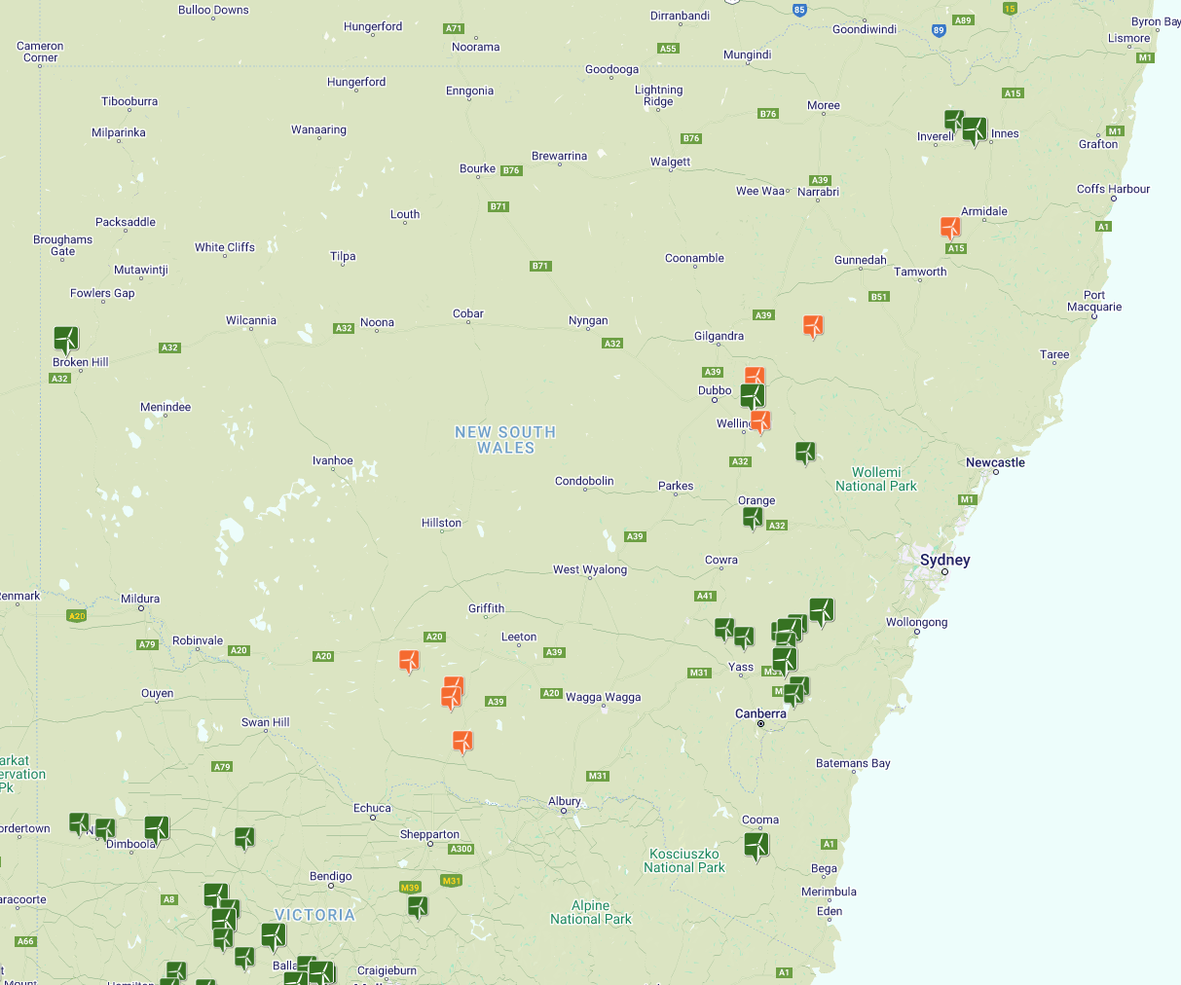
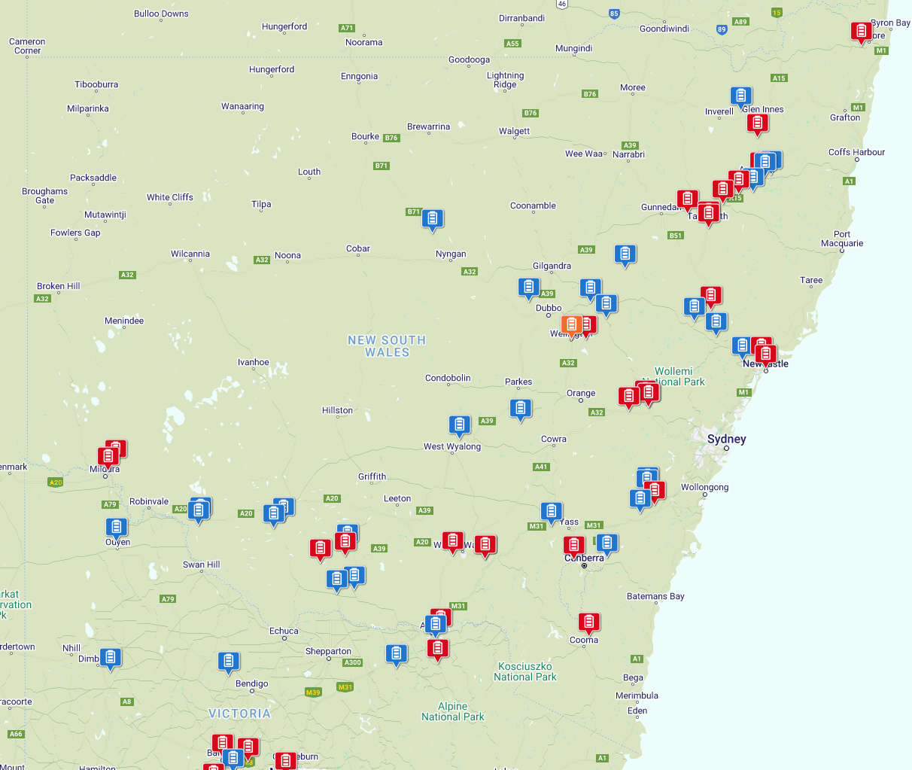
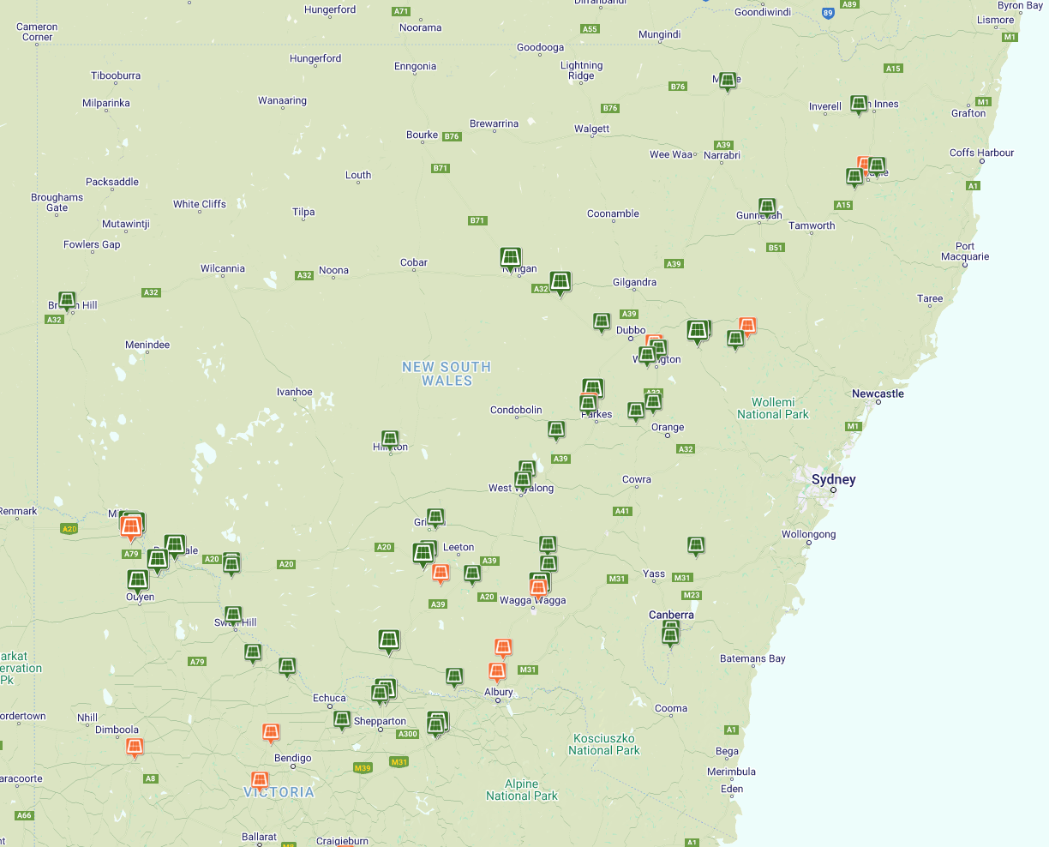
Renewable energy zones and projects
New England REZ
Central West - Orana REZ
$32b investment
$414m community benefit
Hunter – Central Coast REZ
Operating
In construction
Southwest REZ
Illawarra REZ
Announced
Proposed
Source: Renew Economy, Large Scale Solar, Wind and Big Battery Storage Maps, overlaid with NSW gov REZs
Notes:
NSW gov have a Net Zero 2050 goal. The map shows the spread of current and planned renewable energy or RE projects across NSW (green – in operation, others – under construction / assessment / proposed) and Renewable Energy Zones (REZs) where State gov have enabled streamlined assessment and infrastructure planning
All in all, RE development is expected to create $32b investment to 2050, resulting in $414m in community benefit
$414m community benefit sounds great for Councils and local communities, but where does that come from and what will it actually fund?

Slide 3
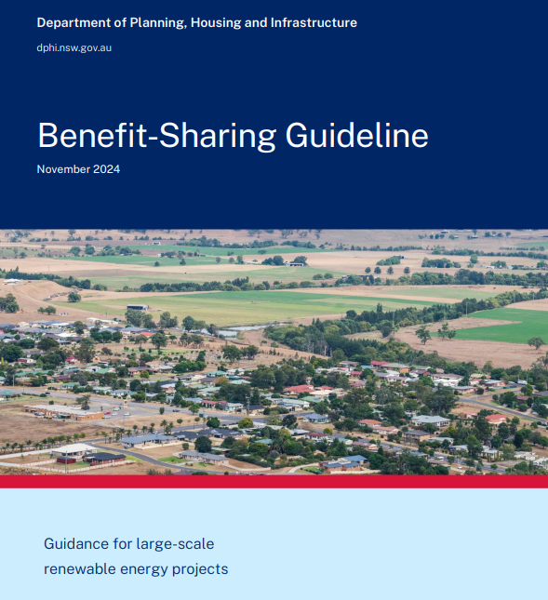
Opportunities
Minimum community benefit contributions (subject to CPI)
  Wind energy – $1,050 / MW / year
  Solar energy – $850 / MW / year
  Stand-alone BESS - $150 / MWh / year
Implemented via a Planning Agreement
Sharing RE benefits to encourage community buy-in and support
  infrastructure
  community events
  education / employment programs
  local organisations and advocacy groups
Notes:
The $414m is estimated by the State gov via their Benefit Sharing Guideline which they prepared to provide more certainty and to document minimum annual community benefit contributions
Large-scale renewable energy projects will need to consider the Guideline and enter into Planning Agreements with local councils
The main intent of these contributions are to encourage community buy-in and support of renewable energy by sharing its benefits. The benefits funded may include funding infrastructure, community events, education and employment programs and local organisations and advocacy groups.

Slide 4
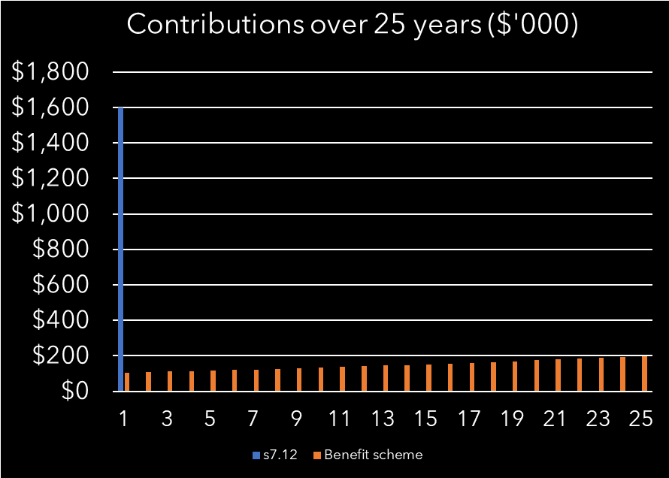
POV: you work in contributions planning
Example: 100MW wind farm operating for 25 years, $160m dev cost
  $1,050 x 100M = $105k per year
  105k per year x 25 years = $2.63m
  With 2.71% annual CPI ~ $3.79m
  In comparison, a 1% s7.12 levy =
  $1.6m paid once
$32b, $414m community benefit
1% = $320m for local infrastructure
Notes:
Now, let’s put ourselves in the point of view of a contributions planner which, given our audience, is probably relatable.
1. Speaking from experience, your first instinct is probably to compare benefit sharing contribution rates with local contributions rates. CLICK In the given example and in majority of cases, Council will collect more contributions through consistent annual community benefit contributions, compared to a one-off contribution under a s7.12 Plan.
2. But because you’re a CP, again, speaking from experience, your next instinct is to make a chart out of this info. CLICK
What this shows us is that the benefit sharing scheme results in a greater amount of contributions however this is over the operational life of the development. The S7.12 levy collects less but is received upfront and can be outright invested or spent on critical infrastructure
CLICK
3. If we go back to the headline figures of $32b investment and $414m in community benefit across the state, theoretically, a s7.12 levy at 1% should yield $320m that councils across NSW can use on local infrastructure

Slide 5
Risks
Sample community benefit items
SSDs are assessed by State Gov
  State gov must ‘have regard’ to any applicable CP and may impose s7.11 / s7.12 (unlikely)
Negotiating between competing interests
  CP POV: Negotiate contributions with Developers
  Community benefit POV: Negotiate contributions with Developers, negotiate how this is spent with Community Benefit Committee
Pitting community benefit against capital works (s7.11 / s7.12)
$24k - Church solar panels
$15k – upgrade local school library
$10k – Sheep Week 2023
$2k – local soccer club uniforms
$15k – iPads for RFS officers
$7k – Bowling Club scoreboards
$8k – Rock wall for public reserve
$13k – Community garden fencing
Notes:
While councils clearly stand to benefit from renewable energy development and we’ve had a visual of the opportunity this presents for councils, there are risks to how Council can implement or use these contributions
1. First is that large scale RE are typically state significant development which is assessed by State Gov
While State must have regard to any applicable CP, they are not required to impose a s7.11 or s7.12 condition.
The likelihood that s7.11 or s7.12 will be conditioned in addition to a VPA requiring community benefit contributions is low because the Guidelines express that standard contribution methods may not be the best fit or may have limited application on RE development
2. The second risk is the negotiation of community benefit between various competing interests
In business as usual CP POV, we negotiate with Developers looking to enter into VPAs to streamline their development, agreeable contributions rate, payment terms
For community benefit contributions, in practice, funds are disbursed depending on an application process to the community benefit committee.
That internal negotiation with the Committee is required in addition to the external negotiation with the Developer. The committee is composed of:
- Community groups – who represent their own respective advocacies
- A developer representative who may prioritise ‘quick wins’ to more easily get community buy-in
Within Council, there is also that push and pull of politically, which projects gain the most support
CLICK FOR EXAMPLE
3. Linked to the internal negotiation required, there is the perceived difference in principle between community benefit contributions and s7.11 / s7.12.
In funding community buy-in and support, there is a risk of foregoing capital works required in response to development impact.
Thinking about that internal push-pull, capital works tend to be bigger amounts, more long-term, less banner-worthy.
In this example taken from a real RE development, there’s nothing wrong with any of the items on the list, all clearly benefit the community, but tends to go to community groups and events, not exactly public facilities funded by s7.11 / s7.12.

Slide 6
POV: you work in contributions planning
Example: 100MW wind farm operating for 25 years, $160m dev cost
  $1,050 x 100M = $105k per year
  105k per year x 25 years = $2.63m
  With 2.71% annual CPI ~ $3.79m
  In comparison, a 1% s7.12 levy =
  $1.6m paid once (~50%)
Notes:
Again, as contributions planners, we might go back to the initial example we used.
Knowing the risk that s7.11/ s7.12 won’t be charged at the beginning (CIRCLE 1), what VPA terms can we negotiate so that capital works aren’t sacrificed and the VPAs can still service Council’s capital works program. We might think about amounts or payment terms developers will sign up to without sacrificing the delivery of our capital works program
In this example (CIRCLE 2), the 1% s7.12 levy is roughly 50% of the community benefit contributions (in orange) over the operational life of the plan.

Slide 7
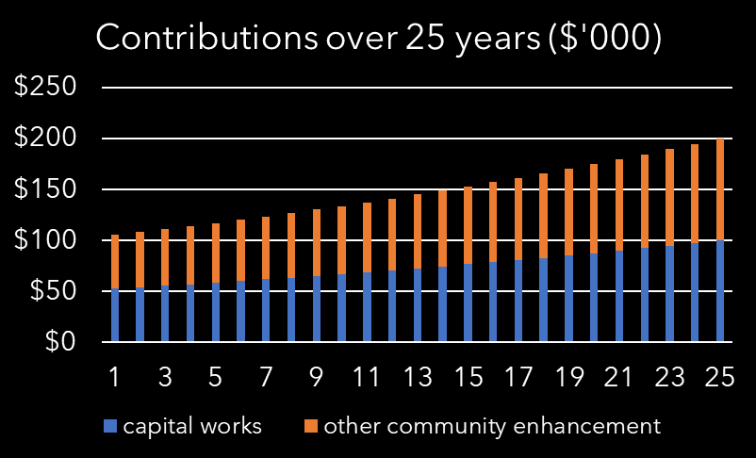
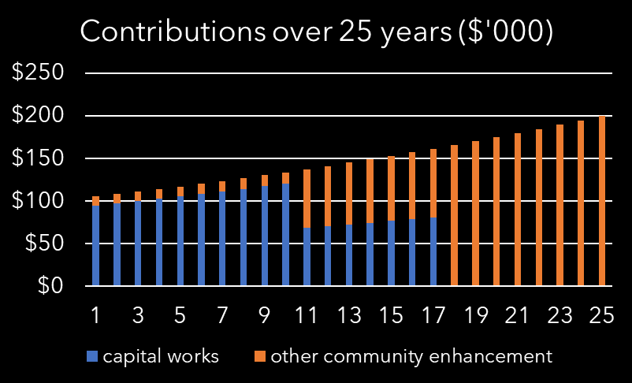
POV: you work in contributions planning
Option 1
Consistent annual capital works funding
Scenario 2
Critical infrastructure required upfront
Notes:
Using that 50% ratio, option 1 shows how this might look like applied through the operational life of the development. This works where consistent annual capital works funding is ideal to Council.
Given the nature of capital works, some of these may be critical to the start of development so CLICK option 2 shows how the same share of funds can be directed to capital works in the early stages of the development’s operational life.
There are a multitude of ways councils can re-jig these, but overall, these are negotiable terms with the Developer because their amount of annual contributions are not affected and remains consistent with Guidelines.
The bigger challenge here is in the internal negotiation for capital works to receive the benefit, and in a timely manner.

Slide 8

Recommendations
Community benefit fund committee common goals and principles
  Capital works contribute to community benefit
  Identify critical items
  Establish a budget / allocation
Planning Agreements Policy
  Direction for Developers and State gov
  Certainty for local councils and community benefit fund committee
Notes:
In working with some of our clients, here are some of our thoughts around how Council can begin to balance community benefit scheme priorities. I know this focuses mainly on regional councils and renewable energy development, but some of these concepts or lines of thinking can be transposed to how any council might approach VPAs.
First and foremost is that the Community benefit fund committee need to establish some common goals and principles that allow them to get on the same page and together, negotiate better terms with developers.
It needs to be established as a principle that capital works do contribute to community benefit and are a critical funding item.
Committee to identify critical funding items and establish a budget or allocation instead of an application process after a VPA has been executed or funds have been received. This could be for the infrastructure fund or other key priorities key beneficiaries.
Adopting a Planning Agreements Policy with the Committee’s goals and principles makes this a more solid commitment and guides Council and the Committee’s negotiation of ideal terms and inclusions. Some councils may choose to reference the State’s Benefit Sharing Guidelines or even make the case for rates above the baseline rates provided. Either way, this serves as a guide to Council, provides certainty for Developers and gives State gov some direction in their assessment of SSDs.
Those were just some thoughts re renewable energy development and the State Benefit Sharing Guideline, particularly from an infrastructure planner’s POV. Aside from environmental sustainability, Councils and communities stand to benefit from RE development and it’s good to get a framework in place that maximises this and ensures infrastructure projects don’t get left behind.
Again, this translates to other contexts outside of renewable energy development in that in negotiating VPAs, councils try to sift through the more ‘grand’ offerings in a VPA and make sure critical infrastructure is also provided or addressed. It’s also generally good for councils to have a Planning Agreements Policy or Guideline so it has a definitive guide or direction, not just for developer certainty but for councils to know what their non-negotiables and priorities are.

Slide 9
Thanks! Questions?
Patricia Sim
Senior Infrastructure Planner
GLN Planning
Notes:
Thank you so much for your time today.
Would love to get thoughts, experiences on the topic
Questions to crowd
– whether councils have experienced being able to charge s7.12 contributions in addition to VPA?
How VPA community benefit funds are allocated in Council? Any to s7.11 / s7.12 works schedule?
Thoughts / experiences re benefit sharing guidlines

Slide 10
Sources
Notes:
https://www.energy.nsw.gov.au/nsw-plans-and-progress/major-state-projects/electricity-transition/how-we-are-transitioning-our-electricity-system?utm_source=chatgpt.com
SSD – Planning Systems SEPP 2021 – Schedule 1, item 20, > or equal to $30m
EP&A Act s7.13 – ‘have regard to’
https://www.lindsaytaylorlawyers.com.au/in_focus/vpas-benefit-sharing-for-renewable-energy-projects-in-nsw/?utm_source=rss&utm_medium=rss&utm_campaign=vpas-benefit-sharing-for-renewable-energy-projects-in-nsw

Slide 11
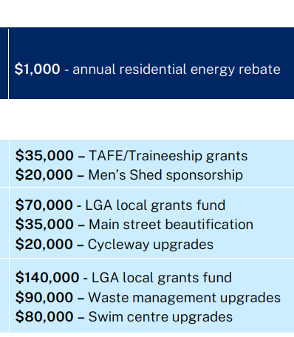
Use of community benefit scheme funds
Guideline example
Sample community benefit items
$24k - Church solar panels
$15k – upgrade local school library
$10k – Sheep Week 2023
$2k – local soccer club uniforms
$15k – iPads for RFS officers
$7k – Bowling Club scoreboards
$8k – Rock wall for public reserve
$13k – Community garden fencing
Notes:
Gullen Range

