Slide 1
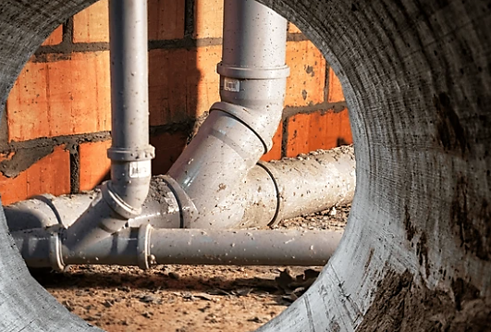
Developer Charges for
Water Supply and Sewerage
The Planner's Summit NSW | Infrastructure, Funding & Delivery - Day 2
12 June 2025
Alessandra Razera
ale.razera@harc.com.au

Slide 2
Infrastructure funding options
Local contributions
S 7.11
S 7.12
Developer works
Internal revenue - user charges
Grants
Borrowings and Loans
Planning Agreement
Water supply & sewerage developer charges
Section 64

Slide 3

Outline of legislation
Section 64 of the Local Government Act 1993
by means of a cross-reference to
Section 306 of the Water Management Act 2000
Section 64 Contributions
or
Developer Charges
?
Notes:
Section 64 of the Local Government Act 1993 enables local government councils to levy developer charges for water supply, sewerage and stormwater. This derives from a cross-reference in the 1993 Act to section 306 of the Water Management Act 2000.

Slide 4
Stormwater infrastructure funding options
S 7.11 & S 7.12 EPA Act 1979
S 64
Local Government Act 1993
Notes:
Local government councils that have stormwater infrastructure, may elect to levy developer charges for stormwater drainage on the basis of section 64 of the Local Government Act 1993 or on the basis of section 7.11 7.12 of the Environmental Planning and Assessment Act 1979.

Slide 5

What are developer charges?
Up-front charges for water supply, sewerage and stormwater infrastructure
Levied on new development and redevelopment
Cover part of the cost of providing the services described on the Levels of Services agreement
Notes:
The underlaying principle of developer charges is: a new development creates a demand for services, and it is therefore equitable that new development pays a contribution towards the capital cost of the infrastructure required to meet that demand.

Slide 6


Purposes of developer charges
Provide source of funding for infrastructure
Provide signals regarding the cost of urban development
They are an integral part of the fair pricing of water related services

Slide 7
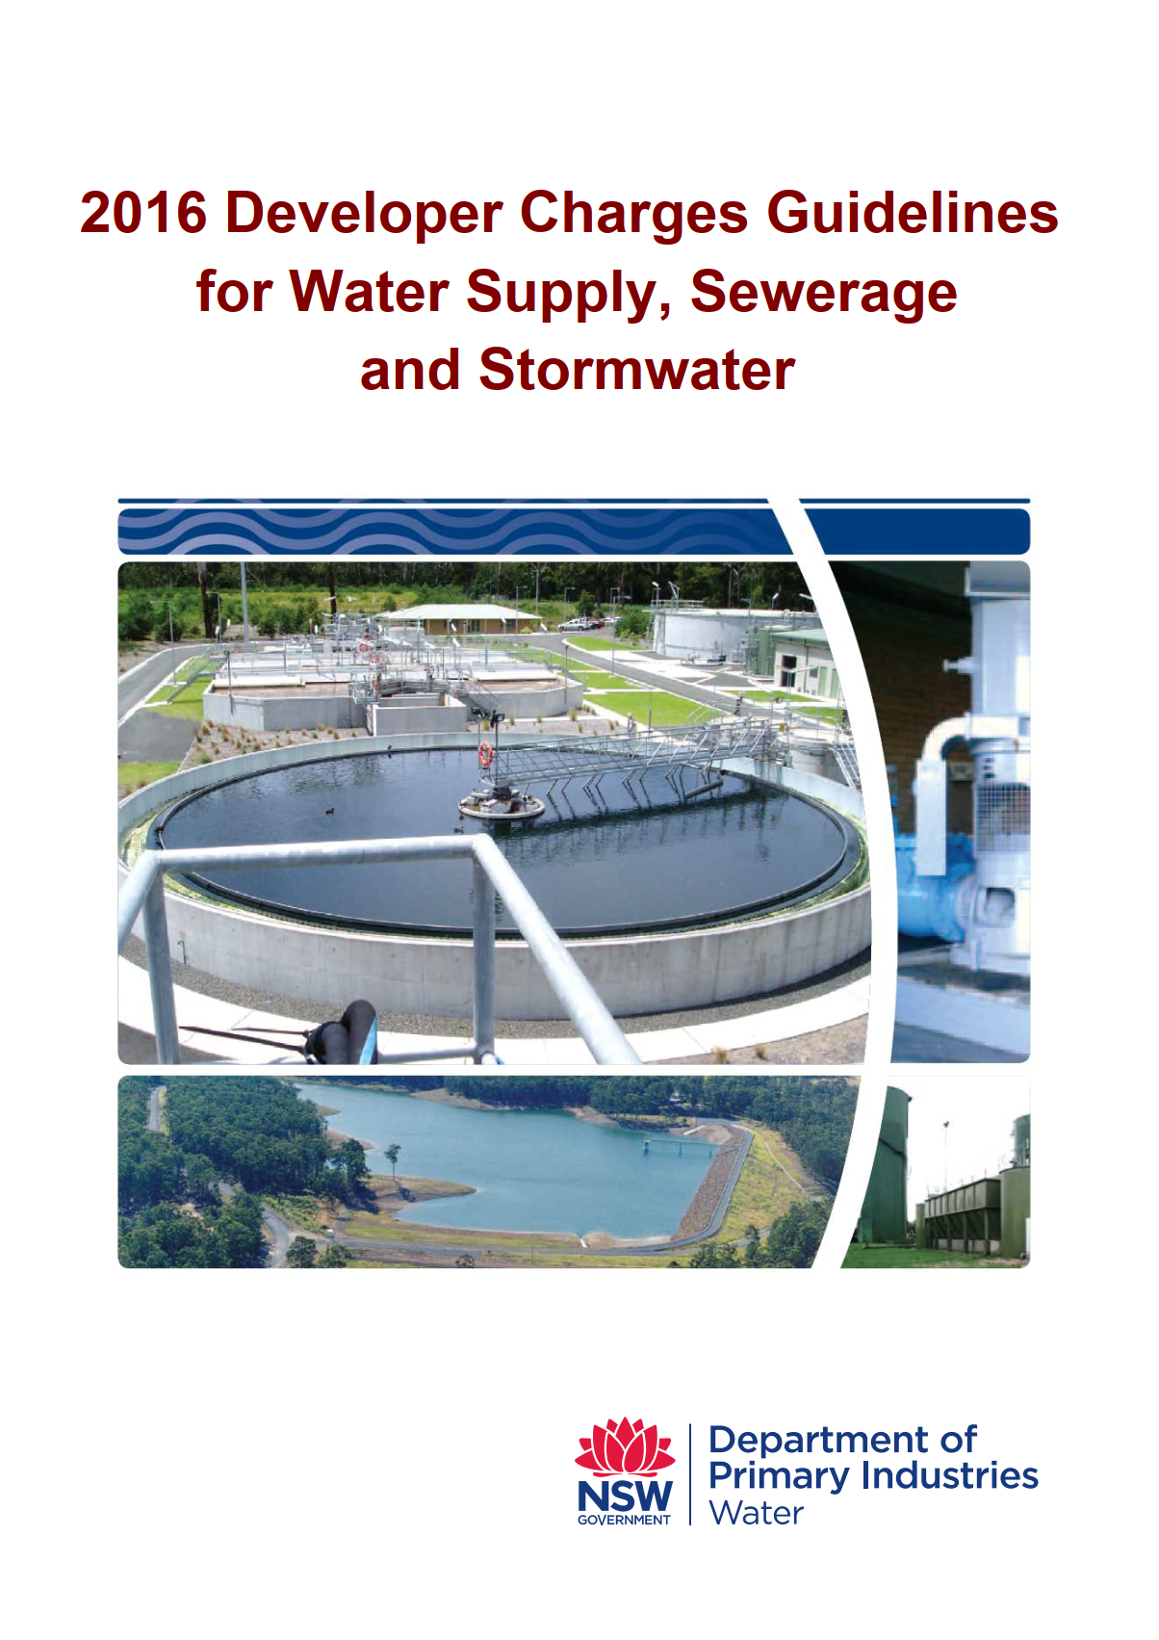
How are developer charges prepared?
https://water.dpie.nsw.gov.au/__data/assets/pdf_file/0007/148372/2016-Developer-Charges-Guidelines.pdf

Slide 8
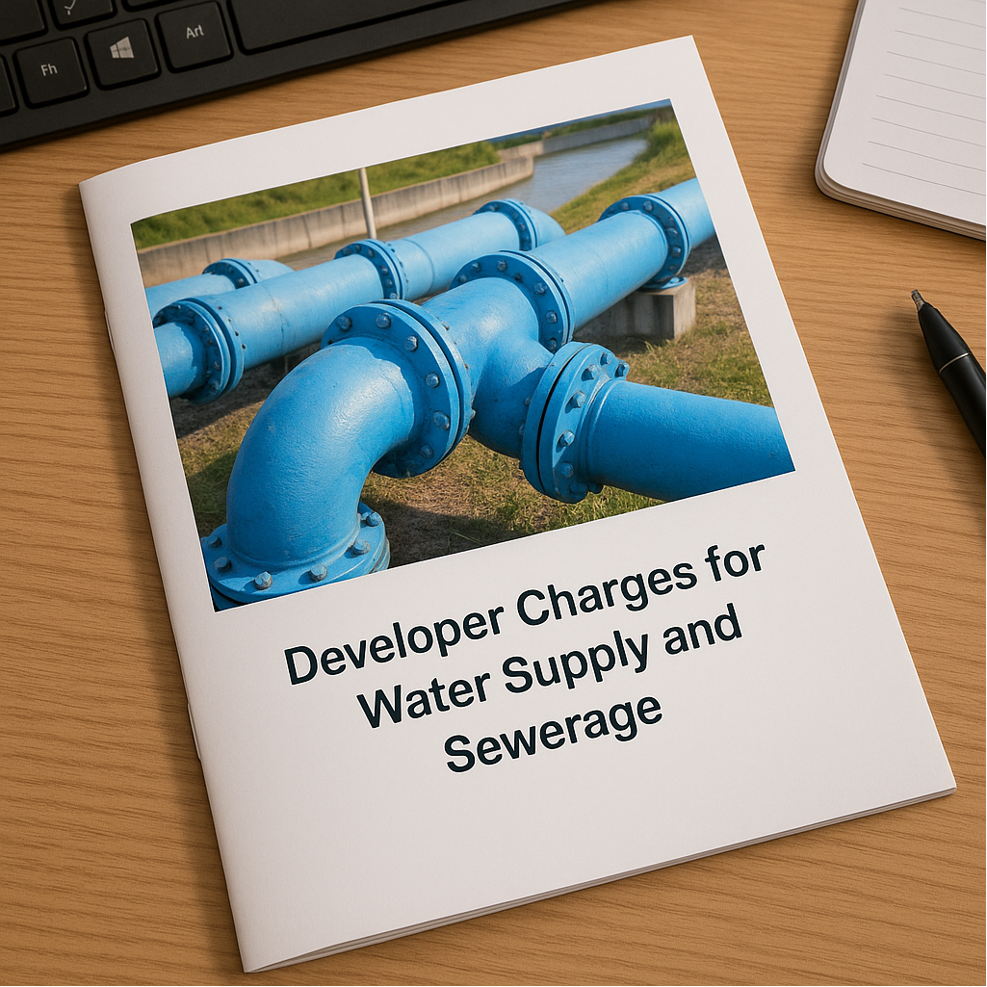
What is a DSP and who can prepare it?
DSP is the instrument that LWUs use to levy developer charges on new development or redevelopment
Development
Servicing
Plan
Prepared by qualified engineering and planning professionals

Slide 9


Developer charges guidelines application
Apply to
Regional NSW LWUs
Councils – Stormwater assets
Sydney Water
Hunter Water
Central Coast Council
Essential Water
Fish River Water Supply
Developments serviced under the WICA 2006 or the Water Industry Competition Amendment Act 2014
Do not apply

Slide 10
Assets included
Existing assets < 30 years
Existing assets > 30 years (e.g. dams and outfalls)
Future assets planned within the next 5 to 10 years
Future renewal works, only if the existing asset has been excluded as it is > 30 years old
Proportion of the asset that will be utilized by the new development

Slide 11
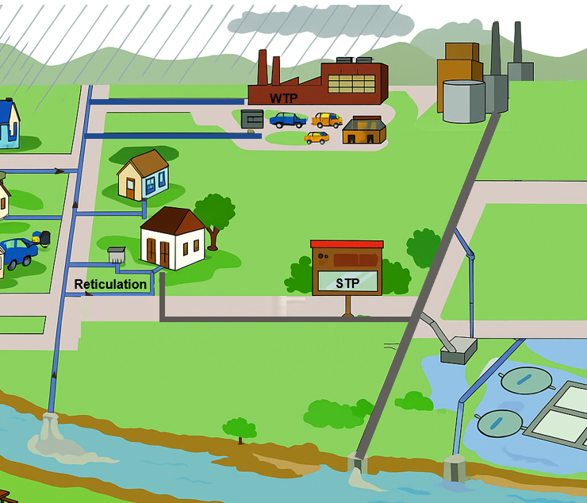
Assets excluded
Assets provided by the developer
Future assets for improved levels of service
Reticulation assets – pipelines that do not have a broader trunk supply function
Assets for out-of-sequence development
Notes:
-Assets for out-of-sequence development, but only if the developer is required to meet the full capital cost of such assets.
Provided that there are no other constraints to the development, the LWU may approve construction of the essential assets ahead of time. In this case the asset will be sized by the LWU, and the full capital cost will be met by the developer. If the asset funded by this developer will serve other future development, the developer should be reimbursed when the LWU collects developer charges from the future development.
the LWU and the developer must enter into an agreement stating how the developer will be reimbursed in the future.

Slide 12
Developer charges calculated vs adopted
Calculated
Adopted
Could be less than the calculated
Maximum charges
Cross-subsidy

Slide 13

When should DSPs be prepared?
Every 5 to 6 years
In between reviews, developer charges should be annually adjusted based on Sydney CPI
DSPs are required to be audited by an independent auditor

Slide 14

Questions
Alessandra Razera
ale.razera@harc.com.au

