Slide 1

Infrastructure funding & delivery Council finance 101
Chris Sleiman – Chief Financial Officer
PIA Planner’s Summit, Day 2, 12 June 2025

Slide 2

Started off as a Forensic Accountant (on the ‘dark side’) - 8 years
Last 9 years (& counting) – Council finance – Parramatta and Inner West (‘saw the light’)
Collaboration with land use planning / and contributions teams
Self-given title as ‘Junior Planner’ (maybe a red P-plater?)

Slide 3

What we’ll cover
Council finance 101
Capital (infrastructure) deep dive
Council reserves - and why they are important
Infrastructure contributions – finance perspective

Slide 4
Council finance 101

Slide 5
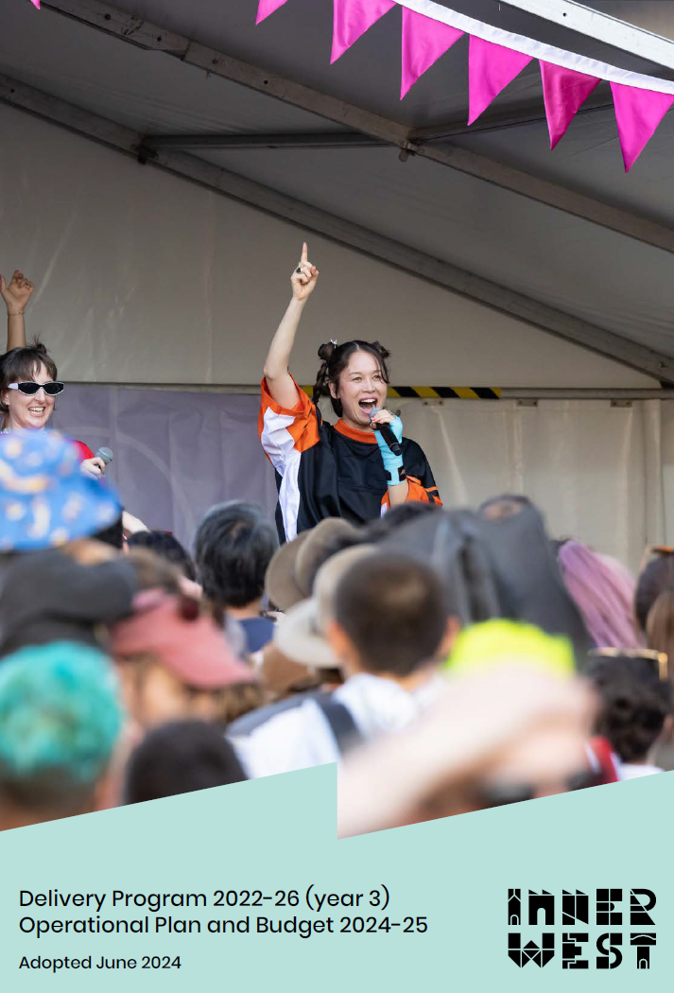
Finance Key Tasks
Responsible for managing Council's financial position and financial commitments in accordance with the Local Government Act 1993, Local Government (General) Regulation 2005, the Local Government Code of Accounting Practice and Financial Reporting and the Australian Accounting Standards.
Key strategic documents include:
Financial Statements
Delivery Program, Operating Program
Quarterly Budget Review Statements
10 Long Term Financial Plan
Finance assist with the collection of $18 million in developer contributions per year and allocate over $23 million towards funding capital projects

Slide 6
Income sources
Consolidated revenue $343m
Grants & Contributions ($43.4m)
General Revenue ($144.7m)
Other Income ($31.2m)
Interest Income ($9.8m)
User Charges and Fees ($66.1m)
Domestic Waste ($47.2m)
Notes:
General Revenue - This includes stormwater levy and net of pensioner subsidies.
User Charges - e.g. Aquatic Facilities, Early Learning Centres, Restoration Fees.
Other Income - like parking infringements, fines, street furniture and commissions, rental income
Operating Grants – Financial Assistance Grant, Library Grants, Transport for NSW Block Grants, Environment Grants
Capital grants – Leichhardt Oval, GreenWay, roads to Recovery. Local Roads and Capital Infrastructure
Capital Grants & Contributions – Received by Council to complete capital renewal or expansion of Council assets for the community. They are provided by State and Federal Government. Capital Contributions are developer contributions received by Council under section 7.11 plans.

Slide 7
Expenditure Type
Consolidated expenditure $311m
Other Expenses ($13.6m)
Employee Costs
($156.4m)
Depreciation ($38.9m)
Materials & Services ($100.4m)
0%
Notes:
Employee Costs – Includes casuals, Employee Leave Entitlements, FBT, Workers Comp, Training
Borrowing Costs – Most significant is Ashfield Aquatic Centre
Materials and Services – Tipping Costs, Contractor Maintenance Costs, Materials and Consumables, Agency Staff, Consultants, Street Lighting Costs, Utilities and Insurance, Legal Fees
Other Expenses – levies e.g. Emergency Services Levy and Waste Levy
Depreciation – Every dollar of depreciation expenditure, Council increases its depreciation reserve to allow for renewal of assets once its due for renewal.

Slide 8
Notes:
The LTFP numbers is information provided with consultation with the workforce management strategy and asset management strategy

Slide 9
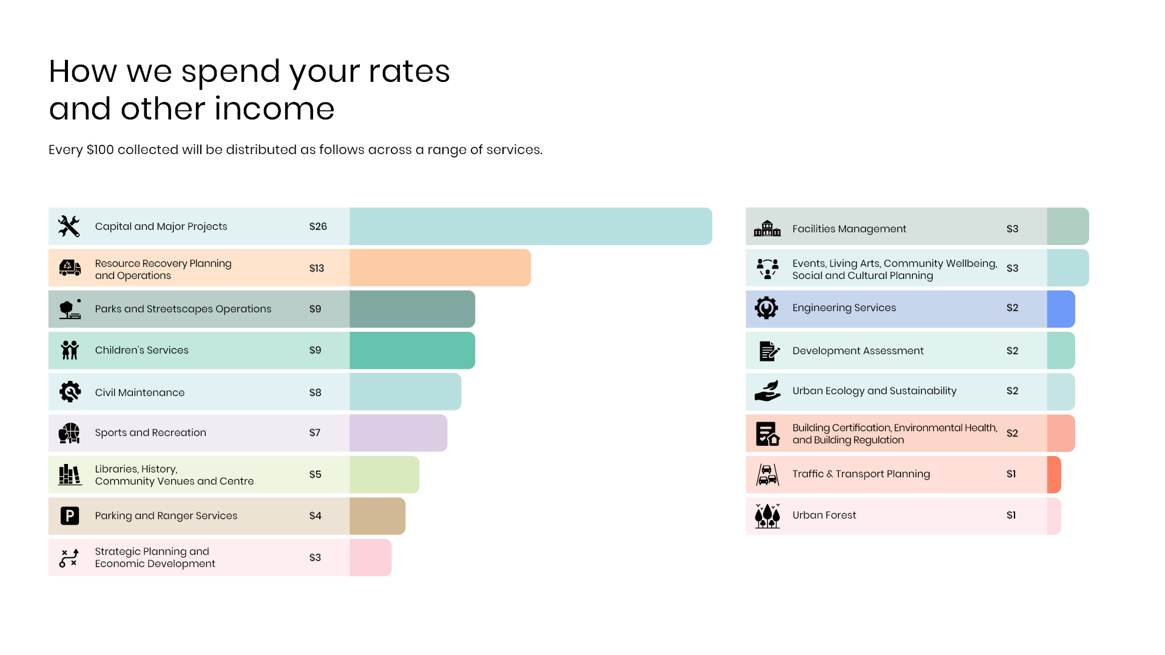
Notes:
Key note, IWC has over $420m in expenditure and a fourth relates to capital!

Slide 10
Capital infrastructure

Slide 11
Notes:
Council backlog % for 2023/24 is $29 million.
Essential to work on renewal of assets to limit reactive maintenance costs.

Slide 12
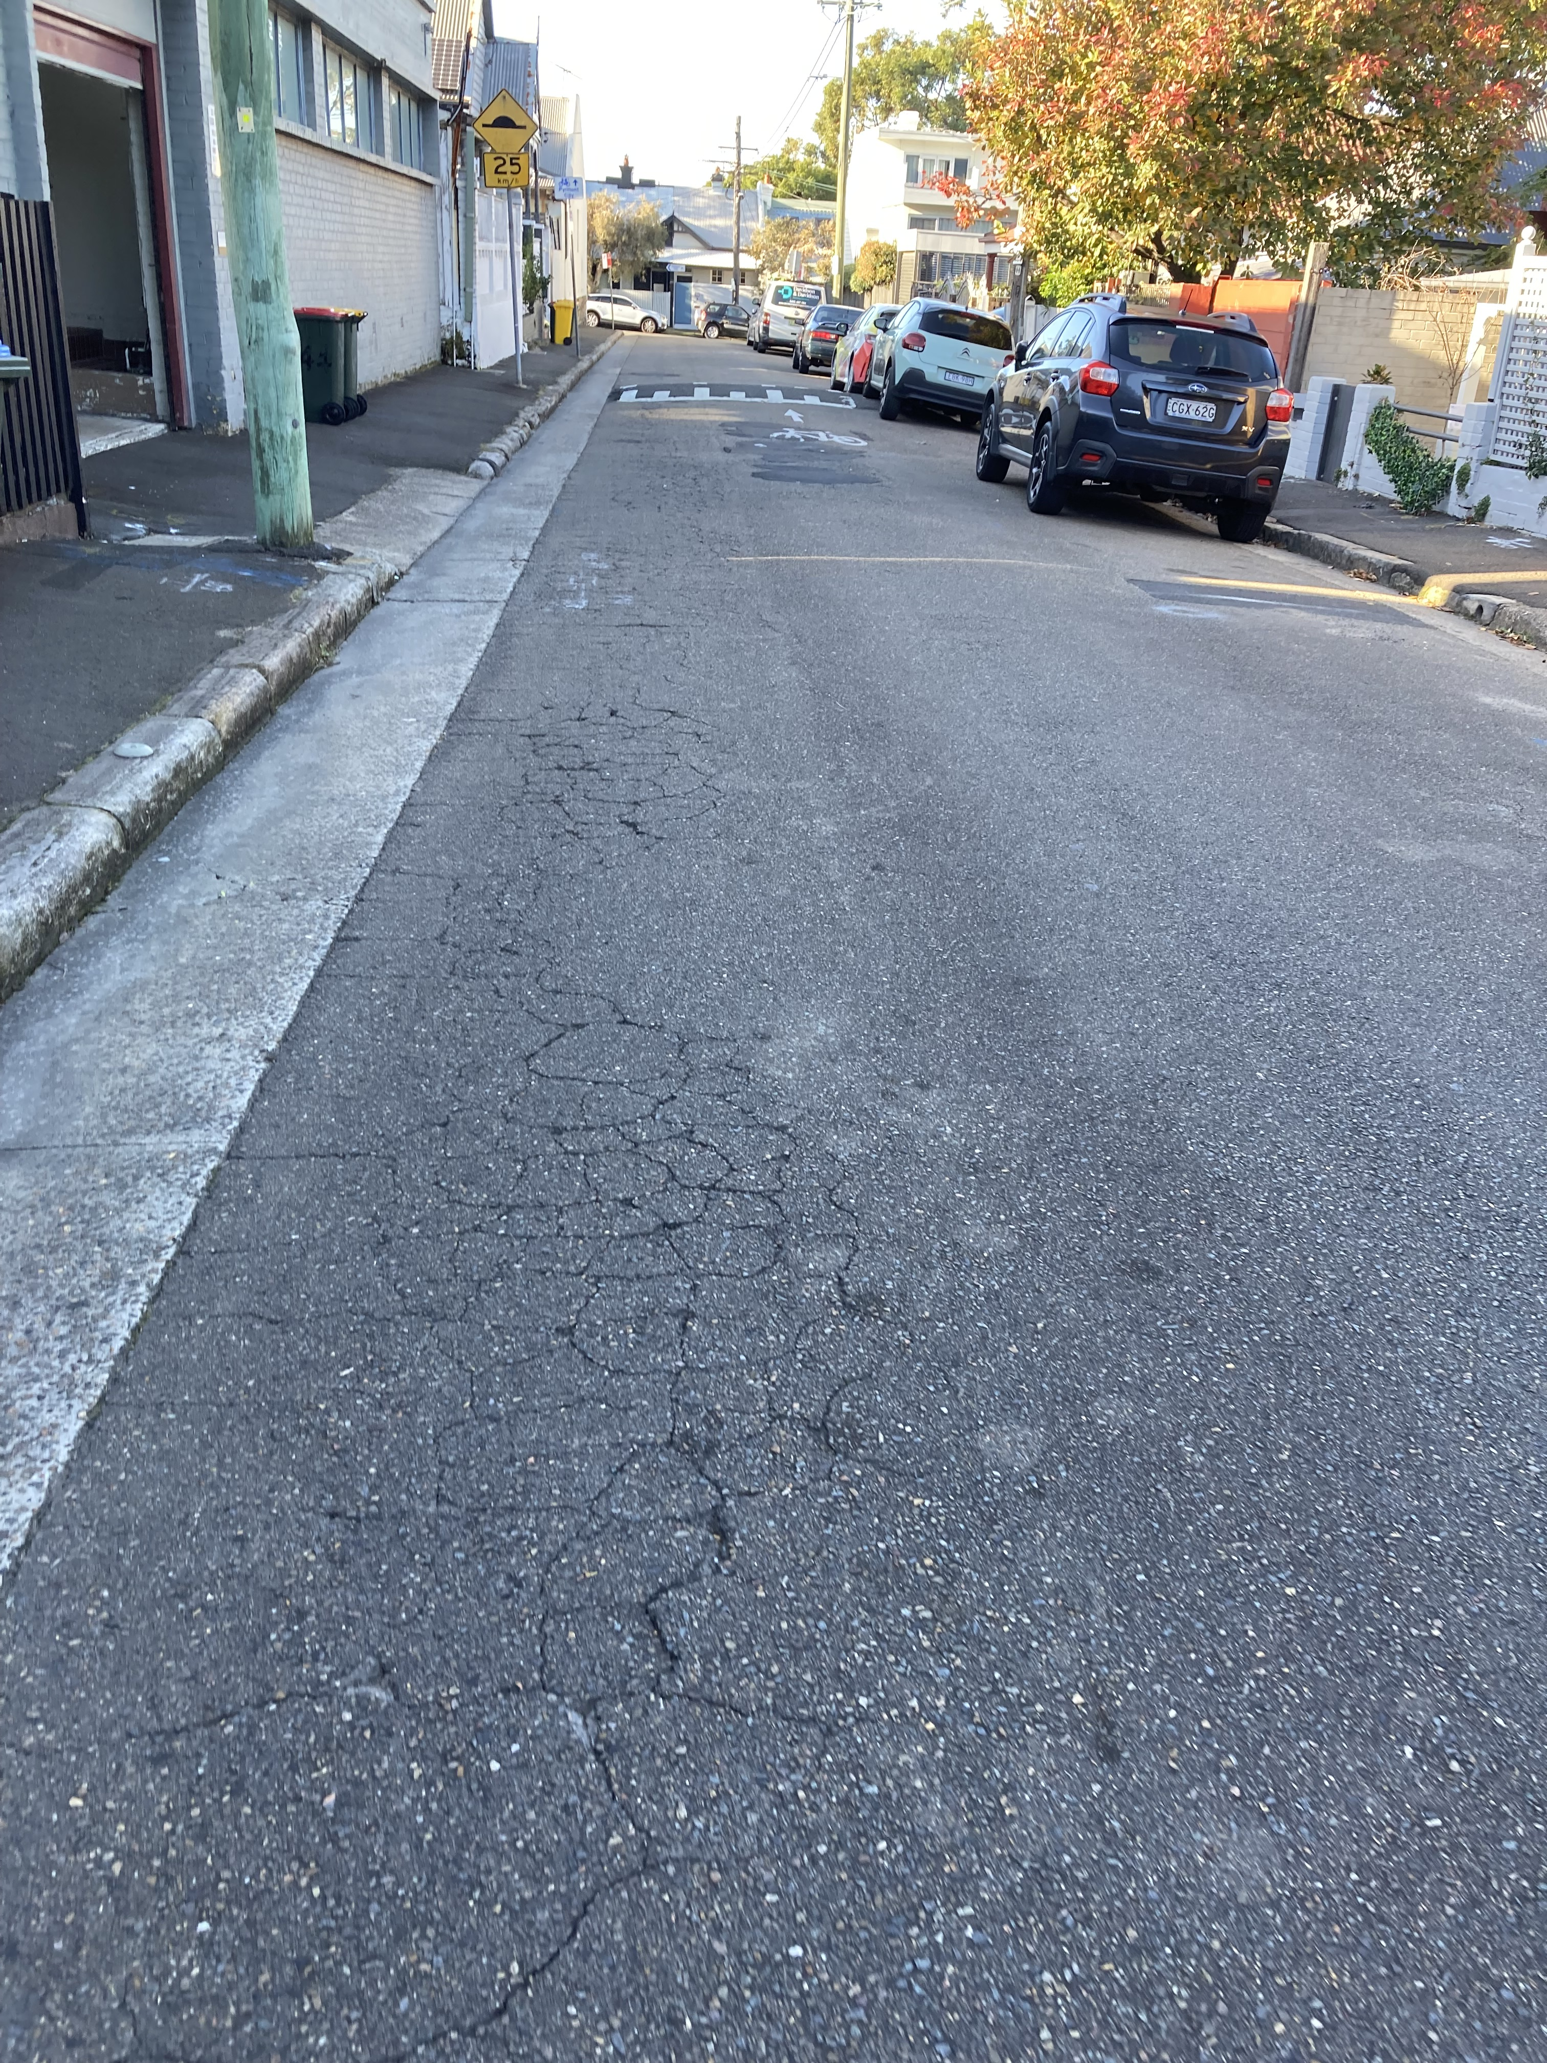
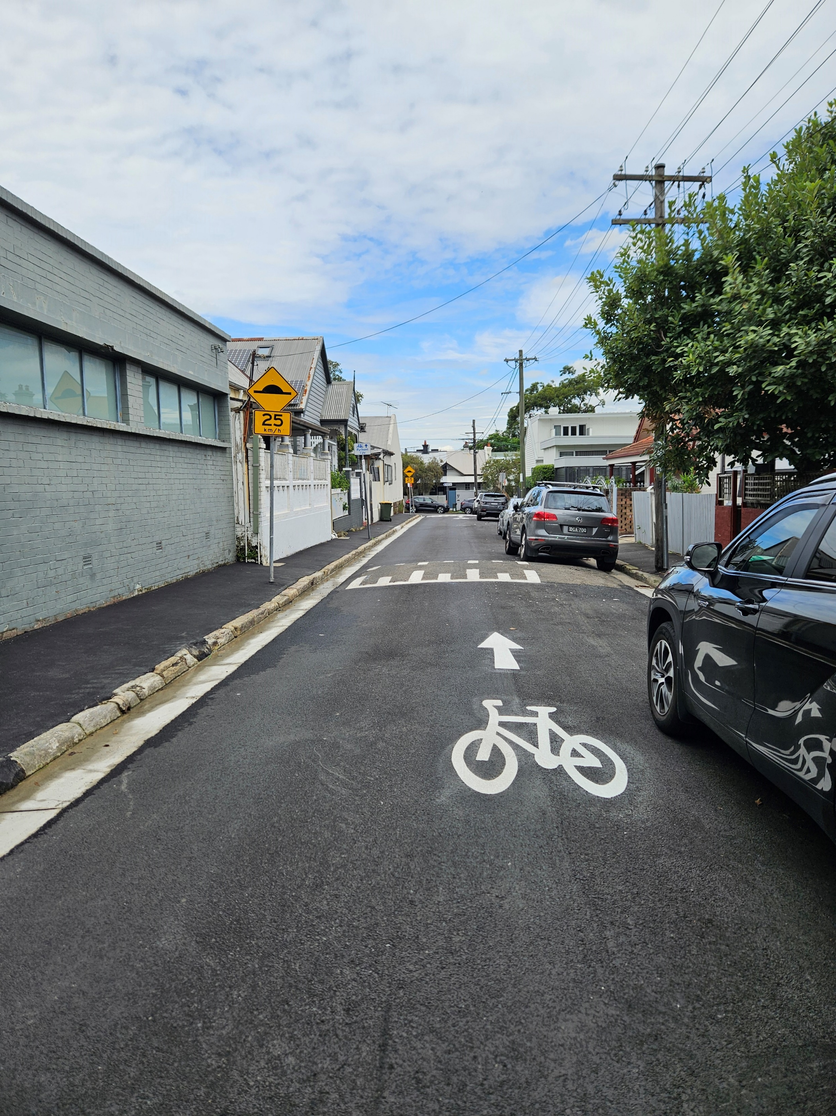
Required when an existing asset is past its useful life or has deteriorated
Examples: roads, footpath, kerb & gutter, stormwater, buildings, parks and sporting fields.
Before
After
Notes:
Council backlog % for 2023/24 is $29 million.
Essential to work on renewal of assets to limit reactive maintenance costs.
Renewal – like for like

Slide 13
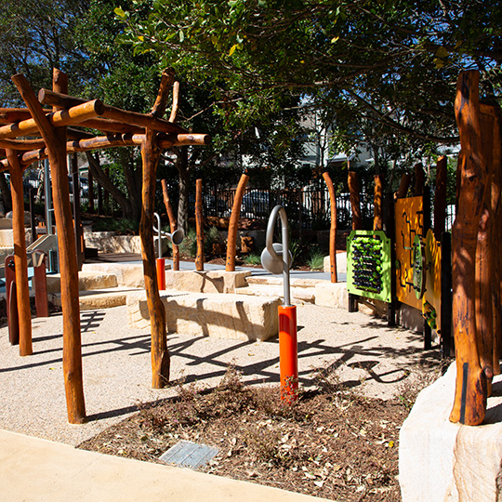
Delivery of a new asset that did not exist previously
Examples: new library, aquatic facility or playground
Notes:
Council backlog % for 2023/24 is $29 million.
Essential to work on renewal of assets to limit reactive maintenance costs.

Slide 14
Council’s Reserves

Slide 15
Reserves 101
External restriction reserves
Funds restricted for use by external entities and have a specific purpose
Examples
  Developer Contributions
  Grants
  Domestic Waste Reserve
  Stormwater Levy
  Special Rates
Internal restriction reserves
Created internally by Council for a specific purpose
Examples
  Employment Leave Entitlements
  Investment Property Reserve
  Infrastructure Renewal Reserve
  Deposits, Retentions and Bonds
  Depreciation Contra Reserve
Unrestricted reserves
Balance of funds used to fund Council operations.
Notes:
Reserves are invested to gain interest. Council have an investment consultant that assists with where Council can invest funds and each month it is required by the Local Government Act that Council provide a monthly investment report to Council.
Developer Contributions – 7.11 contributions paid on plans
Grants – Grants received in advance like mentioned above GreenWay etc
Domestic Waste Reserve – Only used on waste services
Stormwater Levy – part of the rates, charge landowners $25 and for stormwater renewal
Employee Leave Entitlements – Reserve set aside to fund provision of leave entitlements
Investment property reserve – held to purchase investment properties to generate income after Tyne Container sale
Infrastructure renewal reserve - funding aside for urgent capital works
Depreciation Reserve – Every dollar of depreciation is set aside for the reserve to fund essential renewal of assets.

Slide 16
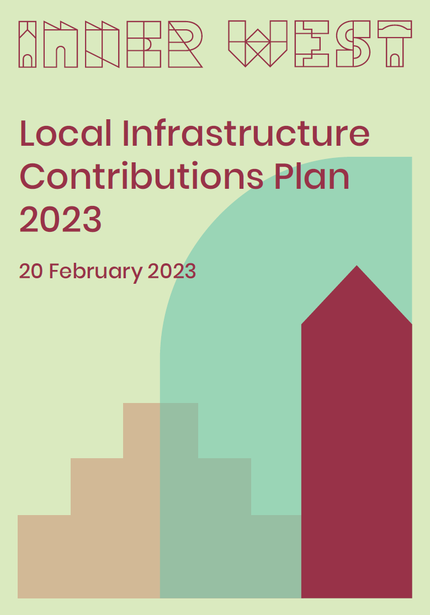
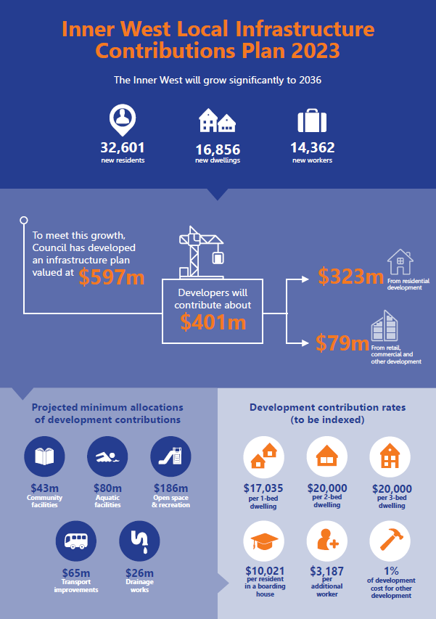
Council is currently exhibiting an Alternate Housing Masterplan to the State Government TOD SEPP which will amend these projections
Notes:
Slide from a presentation to Councillors – key point is developer contributions funds a portion of capital works – Council still need to find other funding types to fund remaining items in plans.

Slide 17
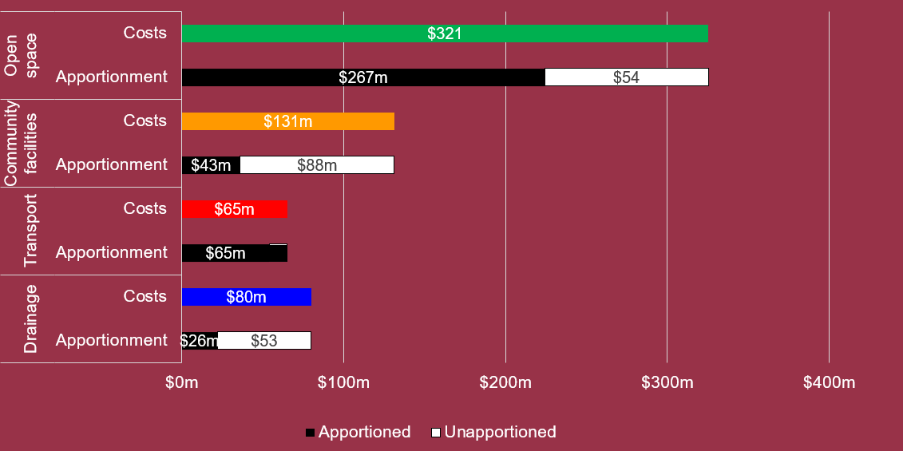
$196m over 15 years
Notes:
that the black and white bars… the black component indicates anticipated funding from new development, the white component relates to the Infrastructure Funding Gap
Slide from a presentation to Councillors – key point is developer contributions funds a portion of capital works – Council still need to find other funding types to fund remaining items in plans.
Community Facilities are the hardest to fund!
Drainage is not as bad as it looks with Sydney Water also accounting for 25% with the remainder from existing residents (appropriate for our Inner Metro context).

Slide 18
Financial impacts of new assets

Slide 19
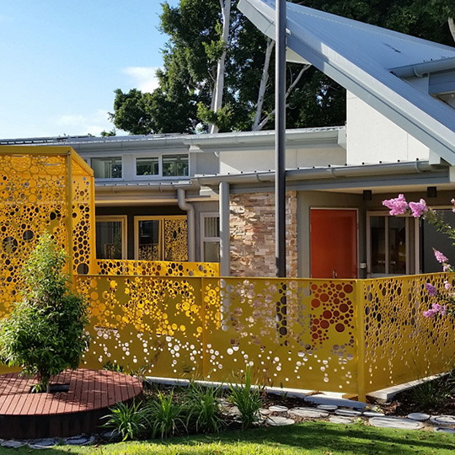
 | Leichhardt Park ELC
Income & Expenditure | 2017/18 FY | 2023/24 FY | Increase/ Decrease
 | $'000 | $'000 | $'000
Total Income | - | 2,002 | 2,002
Total Expenditure | - | 2,543 | 2,543
Net Surplus/(Deficit) from Operations | - | (542) | (542)

Slide 20
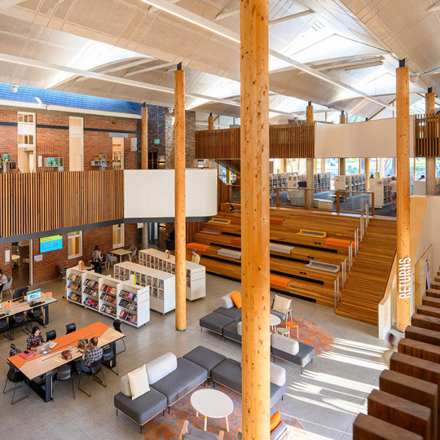
 | Marrickville Library
Income & Expenditure | 2017/18 FY | 2023/24 FY | Increase/ Decrease
 | $'000 | $'000 | $'000
Total Income | 42 | 0 | (42)
Total Expenditure | 3,722 | 4,915 | 1,193
Net Surplus/(Deficit) from Operations | (3,680) | (4,915) | (1,234)

Slide 21
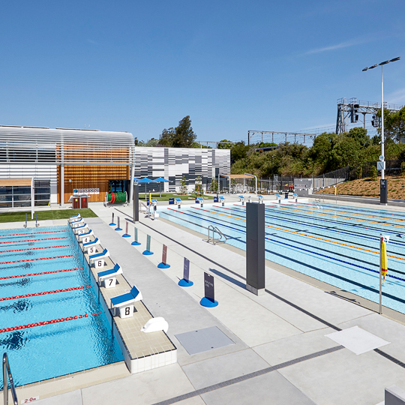
 | Ashfield Aquatic Centre
Income & Expenditure | 2017/18 FY | 2023/24 FY | Increase/ Decrease
 | $'000 | $'000 | $'000
Total Income | 1,363 | 8,054 | 6,690
Total Expenditure | 2,926 | 7,805 | 4,879
Net Surplus/(Deficit) from Operations | (1,562) | 249 | 1,811

Slide 24


Thank You!

